Slide 1
﻿Can GraphQL bring a performance improvement in micro-frontend architectures?
Mold Florian
Notes:
I welcome you to the presentation of my master thesis. The evolving landscape of web technologies presents us with challenges and opportunities, and this thesis explores the potential of combining micro-frontends and GraphQL. We try to find an answer to the question: “Can GraphQL bring a performance improvement in micro-frontend architectures?”.

Slide 2
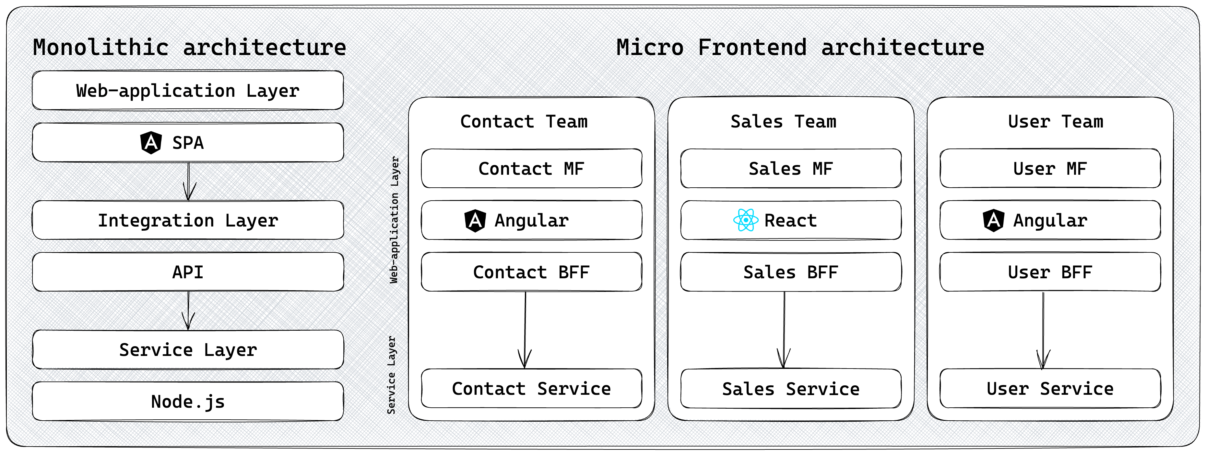

Why micro-frontends _{[1]}
Web applications have evolved into complex systems.
Specialized standalone applications for each domain.
Figure 1: Compare monolithic frontend architectures with micro-frontend architectures.
Notes:
Why should we adopt micro-frontends? In recent years, web applications have evolved into complex systems. This complexity poses a challenge related to scalability, development, and maintainability. To address these issues, a new architectural approach called micro-frontends has emerged.
Micro-frontends should bring advantages of microservices to the frontend. Instead of creating a single large frontend monolith, micro-frontend architectures contain many small independent applications, that each implement a specific domain of the overall application. The figure on the slide shows the difference between the architectures quite well.
The left side shows a traditional frontend monolith. All requirements are implemented in a single frontend application. It communicates with only one API.
The right side shows the same architecture with micro-frontends. Each micro-frontend is responsible for a specific functionality of the overall architecture and communicates with an individual service. Every team develops their micro-frontend autonomously, and the end user experiences the architecture as a single coherent application, like a frontend monolith.

Slide 3
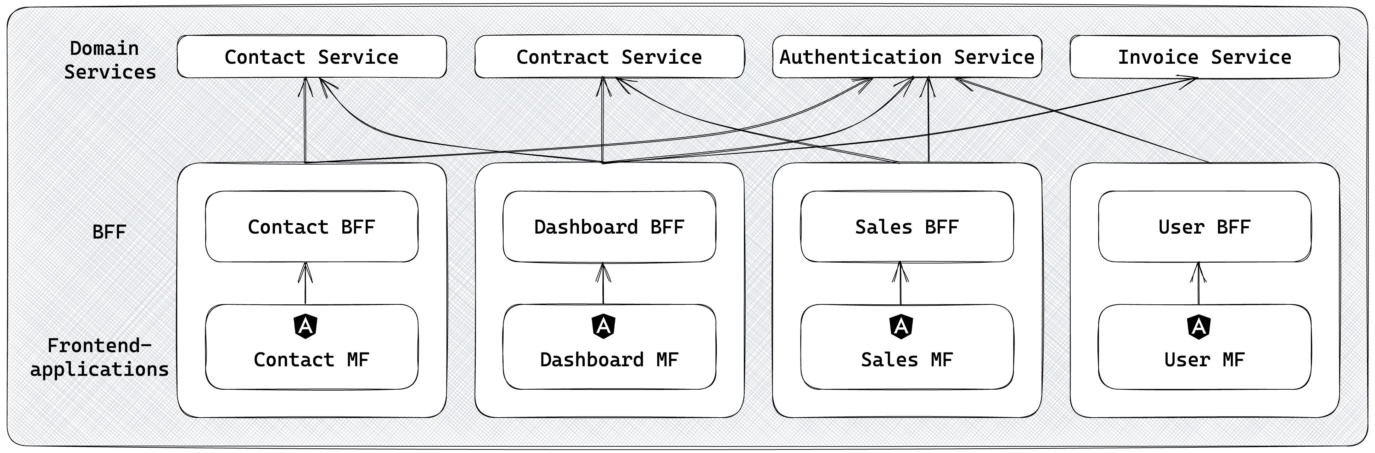
Challenges with micro-frontends _{[1]}
Communication and Data Sharing
Orchestration and integration
Versioning and Compatibility
Cross Cutting Concerns
Figure 2: Cross-Cutting Concerns in micro-frontends example.
Notes:
But it is crucial to acknowledge that every architectural approach comes with a set of challenges. While micro-frontends offer benefits, it's essential to understand the potential downsides.
The four main problems that i identified are:
Communication and Data Sharing: Having multiple independent applications, requires the micro-frontends to communicate with each other. Sharing data and state across applications demands careful design considerations.
Orchestration and integration: As the number of micro-frontends increases, coordinating their integration becomes more complex. Ensuring a cohesive user experience and consistent styling requires effort.
Versioning and Compatibility: Managing compatibility between micro-frontends can be tricky, especially when teams are working independent.
And Cross-Cutting Concerns, which are the main driver responsible for this master's thesis.
Cross-Cutting Concerns: Cross cutting concerns are for example authentication and authorization across multiple micro-frontends. A problem that i want to highlight is the problem that micro-frontends architectures make the same request multiple times also known as over-requesting. For example, as shown on the slide, all micro-frontends make a request for the authenticated user from the authentication service. This leads to a lot of data that is unnecessarily fetched.

Slide 4
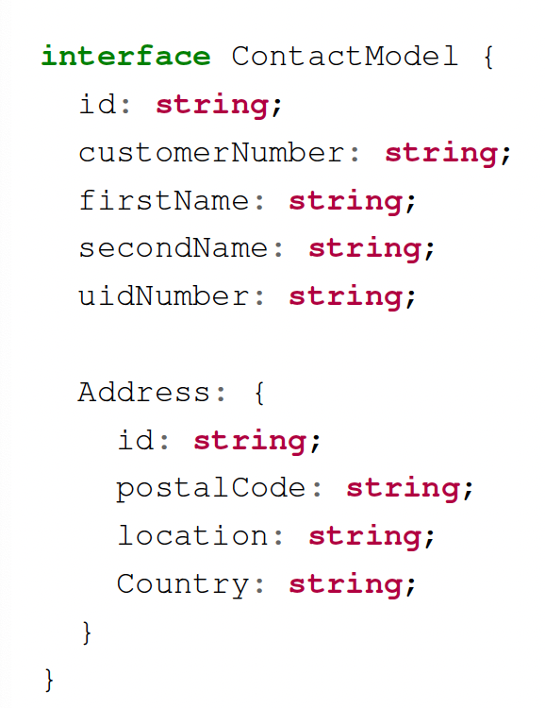
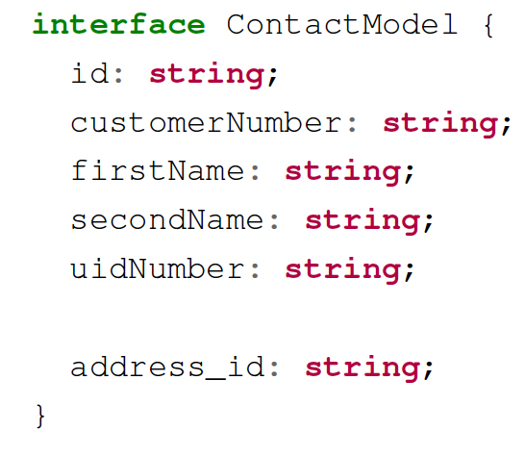
Over-fetching and Over-requesting _{[2]}
Over-fetching describes the problem of fetching more data than needed.
Over-requesting describes the problem of having multiple requests to achieve the needed data-aggregation.
Listing 1: Contact-Model that contains too many fields for a use-case.
Listing 2: Contact-Model model that links to the address-model with the address id.
Notes:
All Micro-frontends need to access shared state, like the authenticated user, which leads to over-requesting.
This exact problem does not occur with monolithic applications; however, all frontend applications (micro-frontends included) encounter the problem of over-fetching and over-requesting data.
Over-fetching describes the problem of receiving more data than needed, which is shown on first listing. The response includes the address, even if it is not needed for the page.
Over-requesting labels the problem of having multiple requests to achieve the required data-aggregation. This problem is shown on the second listing. To get the address another request must be made, and the data must be aggregated. This leads to the problem of making more requests than actually needed.
To solve these problems the Backend-for-frontend pattern is frequently used, where each frontend has its own custom backend. The BFF is responsible to bring data exactly into the shape as it is needed by the client application, therefore the API responses exactly match the requirements.
How do we implement a BFF and can it solve the problems we mentioned before?

Slide 5

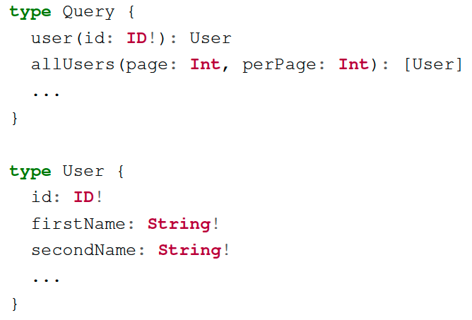
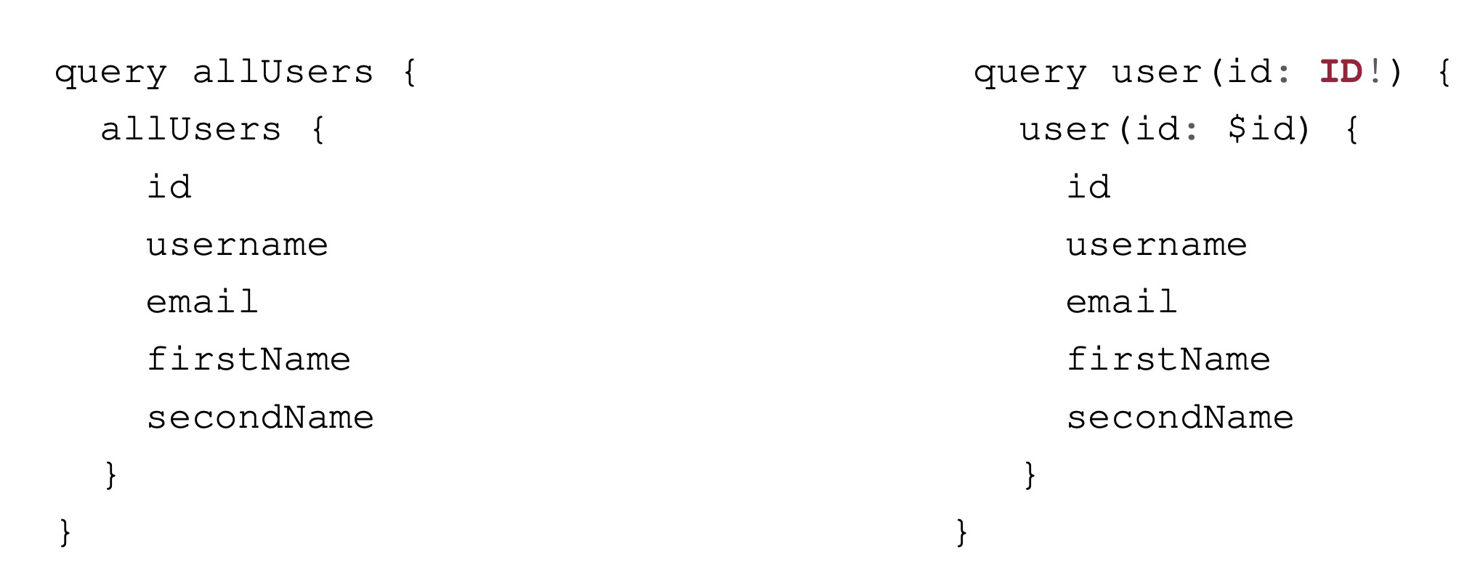
Why GraphQL _{[3]}
A query language for your APIs.
GraphQL provides more flexibility than traditional API technologies.
Listing 3: Connect the GraphQL schema and the user query.
Notes:
GraphQL is perfect for implementing Backend-for-Frontends. GraphQL refers to itself as the query language for APIs.
The big advantage of GraphQL is that the consumer can specify the fields that should be queried. GraphQL defines a schema for its operations. A part of such a schema is shown on the slide. The queries that the consumer can execute are listed below the type Query.
Queries are the equivalent of GET requests in REST APIs. Each query returns a type like user, which fields can be specified inside the schema as shown with the user-type.
The right side of the slide shows a query that is sent to the GraphQL API. The consumer can specify the fields of the user type that should be fetched. GraphQL empowers its consumers to just request the fields that they require, which solves the problems of over-fetching and over-requesting for monolithic applications.

Slide 6
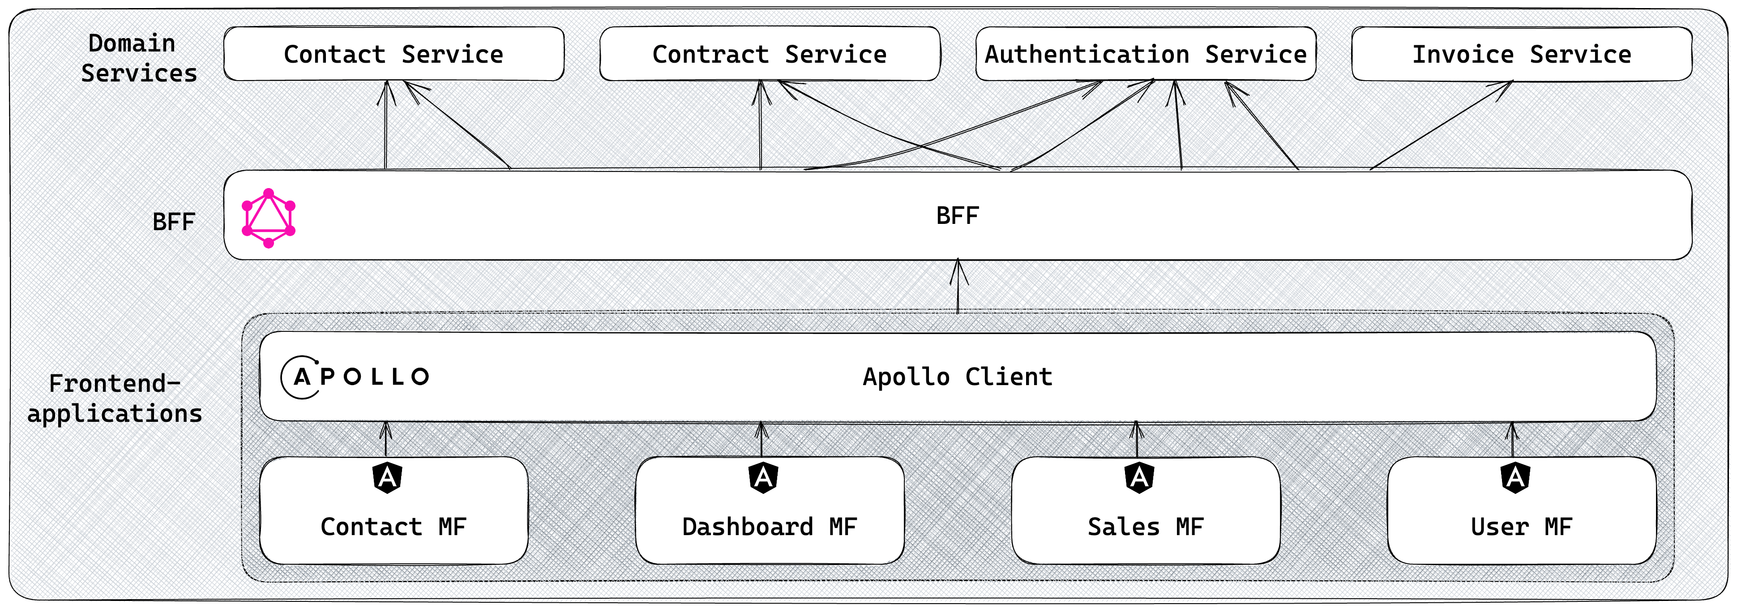
Status quo: Combining GraphQL and micro-frontends
Can the caching layer be shared by all micro frontends regardless of the frontend framework?
Is it possible to retrieve only fields that are not already in the cache?
Caching Layer
Figure 3: Take advantage of GraphQL caching behavior to reduce roundtrips to the server.
Notes:
This leads me to the question, whether we can combine GraphQL and micro-frontends to address the challenges mentioned before.
GraphQL solves the problem of over-fetching and over-requesting in monolithic applications. But the problem of making duplicate requests in micro-frontend architectures still exists. As seen on the slide, GraphQL enables the architecture to use a single API for all micro-frontends, in contrast to the figures before.
Many GraphQL clients offer a caching layer, which is shown on the slide. I have chosen Apollo Client, as it most used and popular library for GraphQL. By default, each micro-frontend has its own cache instance.
The thesis investigates whether it is possible to use a single cache instance for all micro frontends. This caching layer should be to eliminate duplicate requests, since the micro-frontends can load the data from the cache. This should reduce the network traffic.
Another potential improvement that is explored is whether fields of queries, which are already cached can be removed from GraphQL queries. This would reduce the network traffic even more, because less content is sent and received from the server.
I will go into more detail on the theory behind this potential improvement on the next slide.

Slide 7
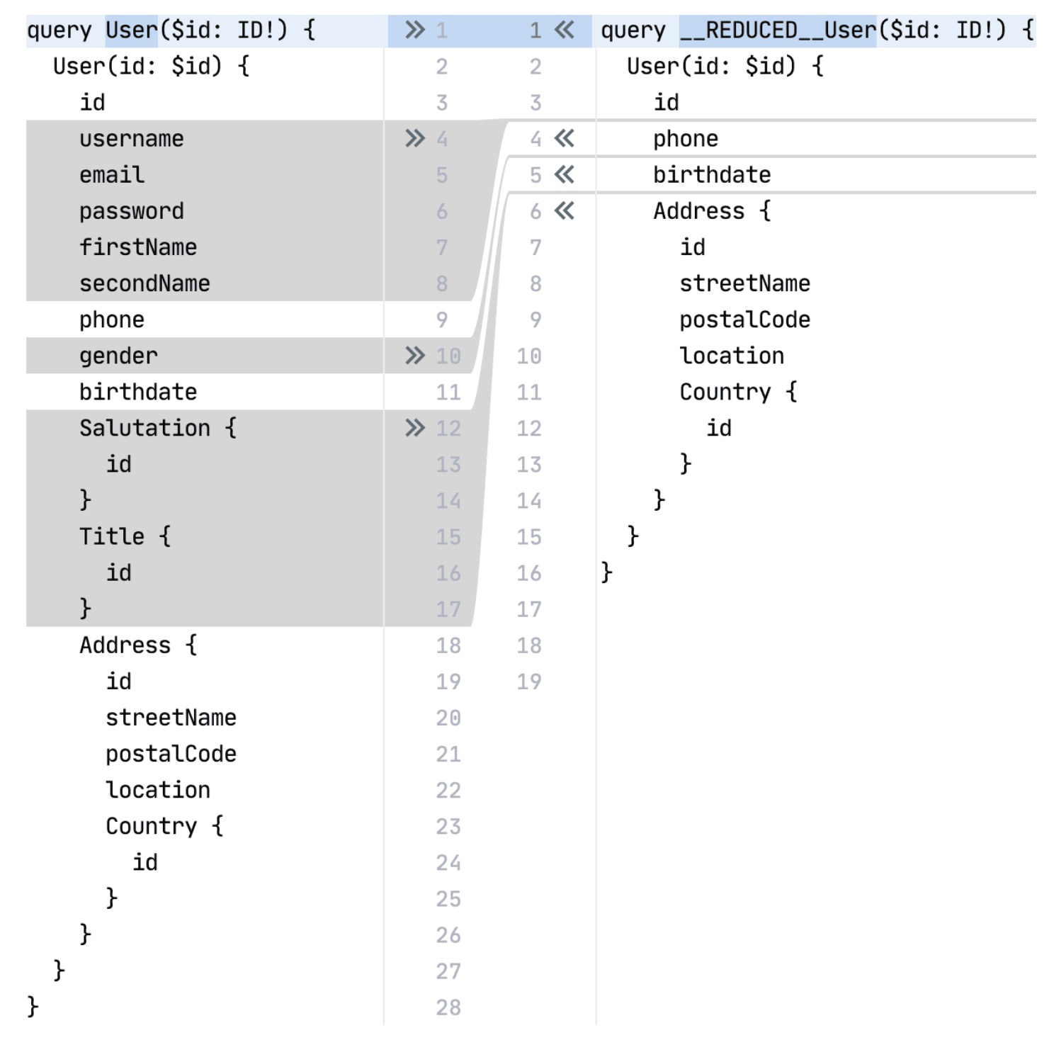
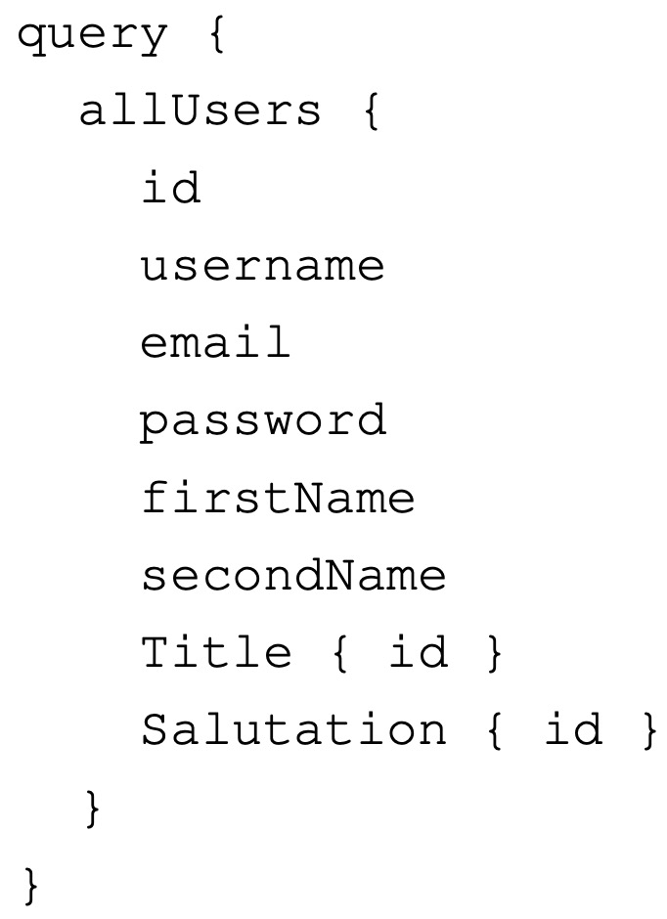
Query reduction theory
Queries share selection sets.
Remove fields from queries that are already in the cache.
leads to
Listing 4: Prefetching user fields in allUsers query leads to smaller query in user query
Notes:
The motivation behind the approach i mentioned before is that different frontend pages need the same data slightly varied in most cases. I will explain it with an example.
When the left query on the slide is executed, all users are fetched from the GraphQL API. The query fetches the id, username, email, password, for all users and so on.
The client now fetches the detail view of a user. By default the left query on the right half of the listing would be executed. But many of those fields that are required for the query were already fetched with the allUsers query and stored inside the cache. By utilizing the cache (named query reduction), the query on the right is fetched instead. The fields which were already fetched with the allUsers query are removed from the query and only the necessary fields are fetched. This should reduce the request and response size.
No GraphQL Client offers this functionality out of the box. Therefore, It was evaluated if such a functionality can be implemented using Apollo Client.

Slide 8
Hypotheses
Hypothesis 1: A micro-frontend architecture using a shared GraphQL caching layer with query reduction can solve the problems of over-fetching and over-requesting inside a distributed architecture. The total number of network requests and network traffic can be drastically reduced.
Hypothesis 2: The caching strategy proposed in this thesis is versatile enough to be effectively implemented in various contexts, providing sufficient flexibility to be independent of the technology used.
Notes:
Based on the status quo and potential improvements, I have formulated two hypotheses.
Hypothesis 1: A micro-frontend architecture using a shared GraphQL caching layer with query reduction can solve the problems of over-fetching and over-requesting inside a distributed architecture. The total number of network requests and network traffic can be drastically reduced.
Hypothesis 2: The caching strategy proposed in this thesis is versatile enough to be effectively implemented in various contexts, providing sufficient flexibility to be independent of the technology used.
Now that we have established our hypothesis, let’s move to the methodology

Slide 9
Methodology
Extensive literature research.
Implement a prototypical micro-frontend architecture.
Implement a communication architecture between the micro-frontends.
Implement a shared Apollo Client caching layer.
Implement an Apollo Client extension to existing remove fields from queries. _{[4]}
Notes:
I have started with an extensive literature research about micro-services, micro-frontends, GraphQL and GraphQL clients like Apollo Client.
Afterwards i have planned and implemented a prototypical micro-frontend architecture. After the architecture has been finalized, i implemented a communication layer for the micro-frontends. Building on top of the communication layer, i implemented the shared GraphQL caching layer, which was mentioned as an improvement on the status quo slide.
The final step included implementing the query reduction mechanism, as an extension to the Apollo Client. This was also mentioned on the status quo slide as well.
The final prototype consists of every possible improvement to circumvent over-fetching and over-requesting that I mentioned before. However, does this bring the desired performance improvements?

Slide 10
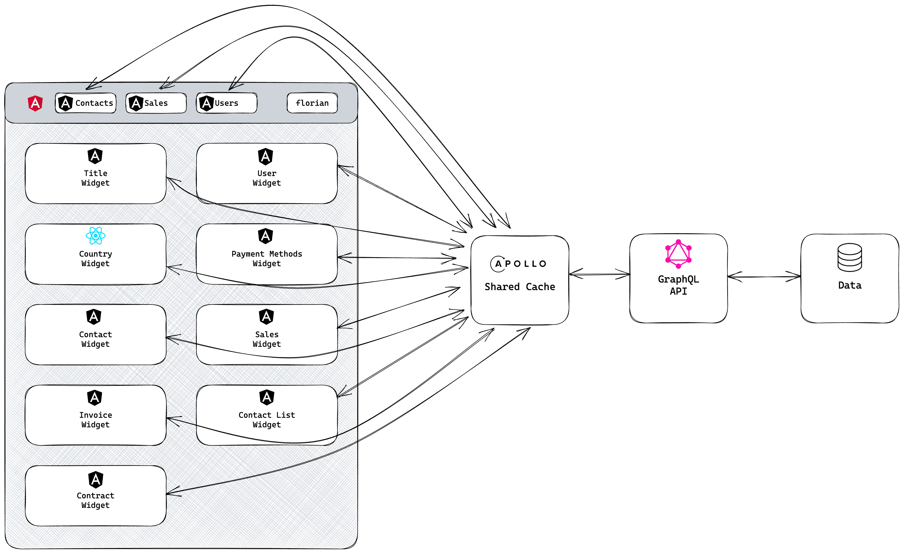
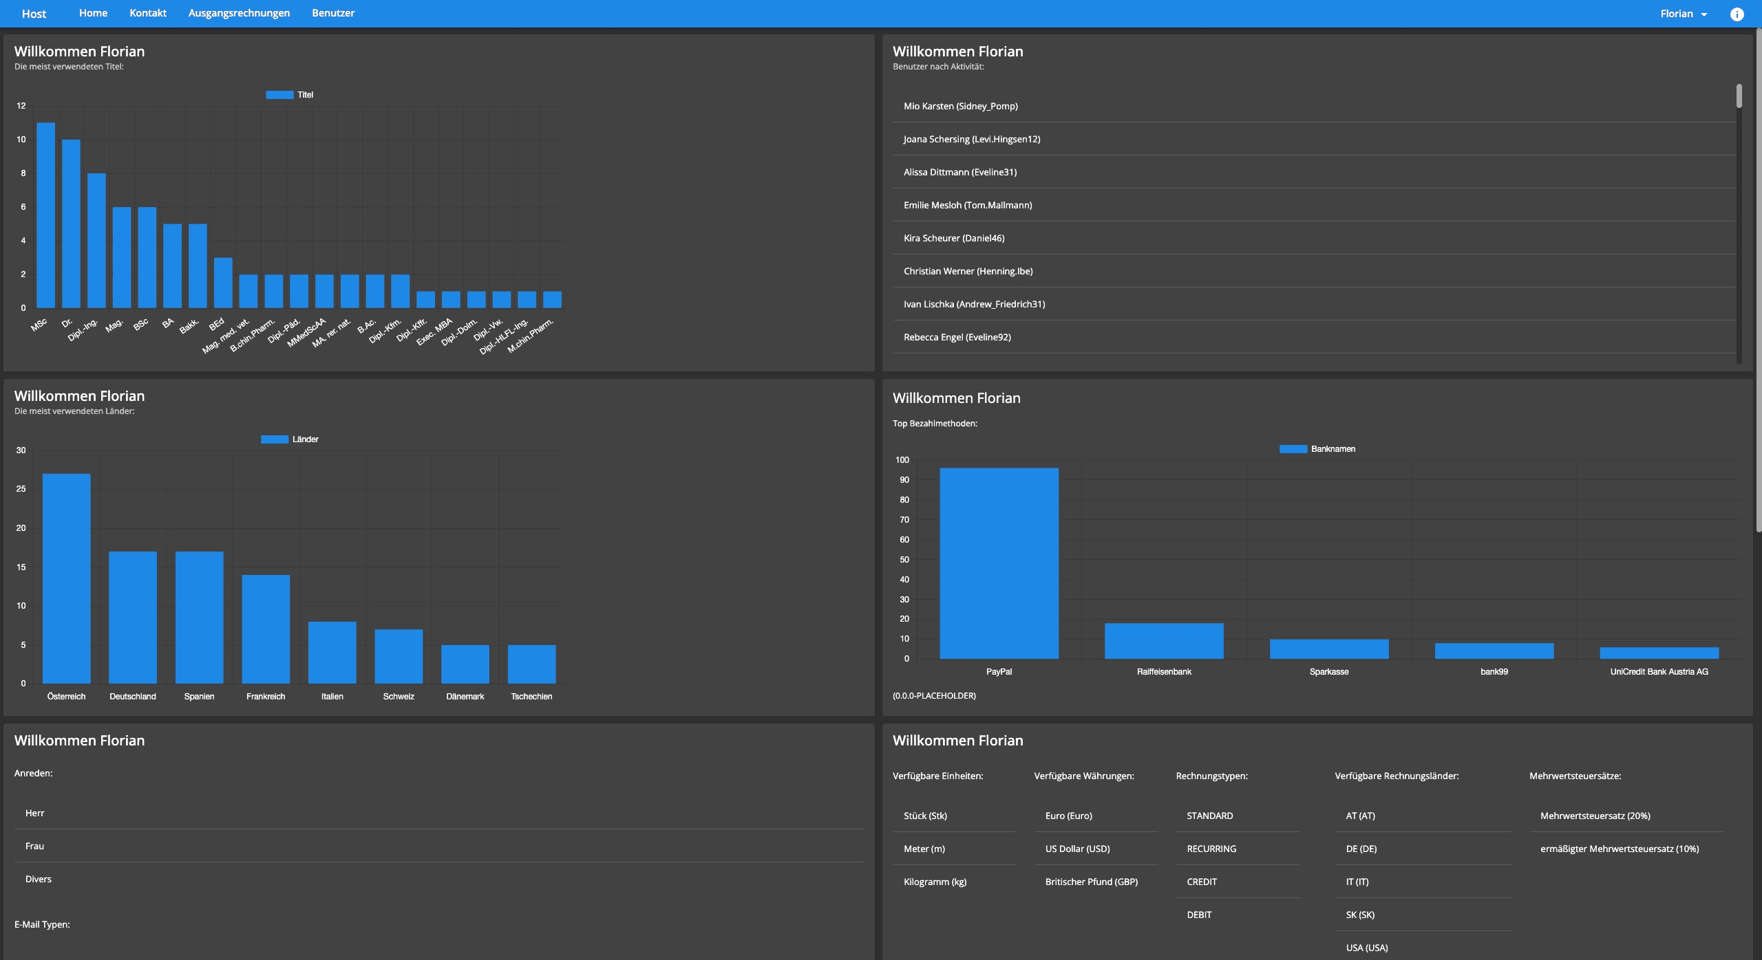
Micro-frontend prototype
Challenges:
Understand Apollo Client cache.
Integrate React micro-frontend.
Implement the query-reduction mechanism.
Figure 4: The micro-frontend architecture.
Notes:
Before we dive into the results, let me show you the final version of the prototype. As we see on the slide (in the navigation bar) the prototype consist of four bigger micro-frontends (Contacts, Sales, Users, Dashboard). The dashboard contains various widgets (micro-frontends), which were implemented using Angular and one in React. The micro-frontends are rendered inside an application shell to appear like a single application to the user.
I am showing a screenshot from the real application now, which as you can see resembles the structure from the figure from before.
The development also presented some challenges for me like:
Deeply understanding the Apollo Client caching structure to be able to share a single instance of the cache.
Integrating a React micro-frontend into the architecture
Implementing the query-reduction mechanism. It required a deep understanding of the caches internal structure.
This prototype was used to measure the performance regarding the hypotheses.

Slide 11
Most significant results: Measurement approaches
Separate cache, no reduced queries
Shared cache, no reduced queries
Shared cache, reduced queries
Approach
Approaches
Approach
Approach
Notes:
To better understand the results, i want to explain the methodology used to measure the performance. The results were recorded in two user journeys throughout the prototype.
Three different approaches were used to measure and compare the performance.
The first approach is a naive approach, where all micro-frontends use a separate cache instance.
The second approach is where the micro-frontends share a common caching layer.
The third approach is where all micro-frontends share a common caching layer and remove existing fields from queries with query reduction.
The approaches are important for the evaluation of the results.

Slide 12
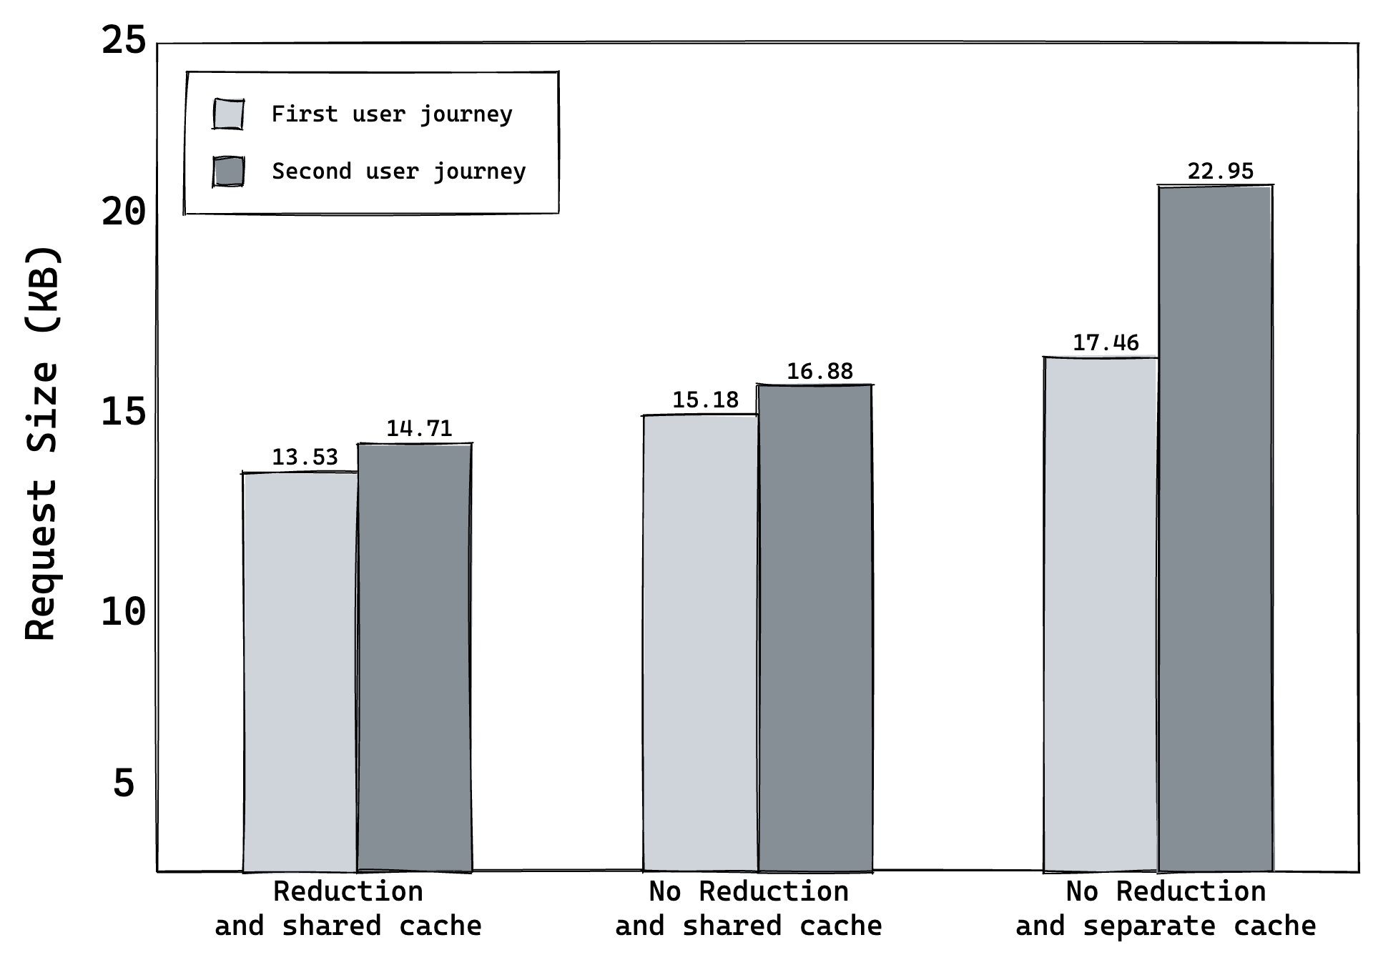
Most significant results: Network request size
Difference in request sizes are small.
Query reduction brings no significant improvement.
Number of requests is reduced with shared caching layer.
1. Approach
2. Approach
3. Approach
36 R
37 R
36 R
37 R
47 R
62 R
Figure 5: Request size comparison between the three approaches.
Notes:
I will start with the most significant results in terms of the network request size.
The comparison between the three approaches is shown as a bar chart on the slide. The differences in the request size are not significant as you can see. They are in the kilobyte range. The bar-chart also features the number of network requests per approach.
The shared caching layer reduces the number of network requests by 11 for the first- and 25 requests for the second user journey. This explains the much higher size difference for the second user journey’s first approach.
Query reduction reduces the size of the request body, because the removed fields are not sent along the HTTP body, but query reduction can’t omit requests.

Slide 13
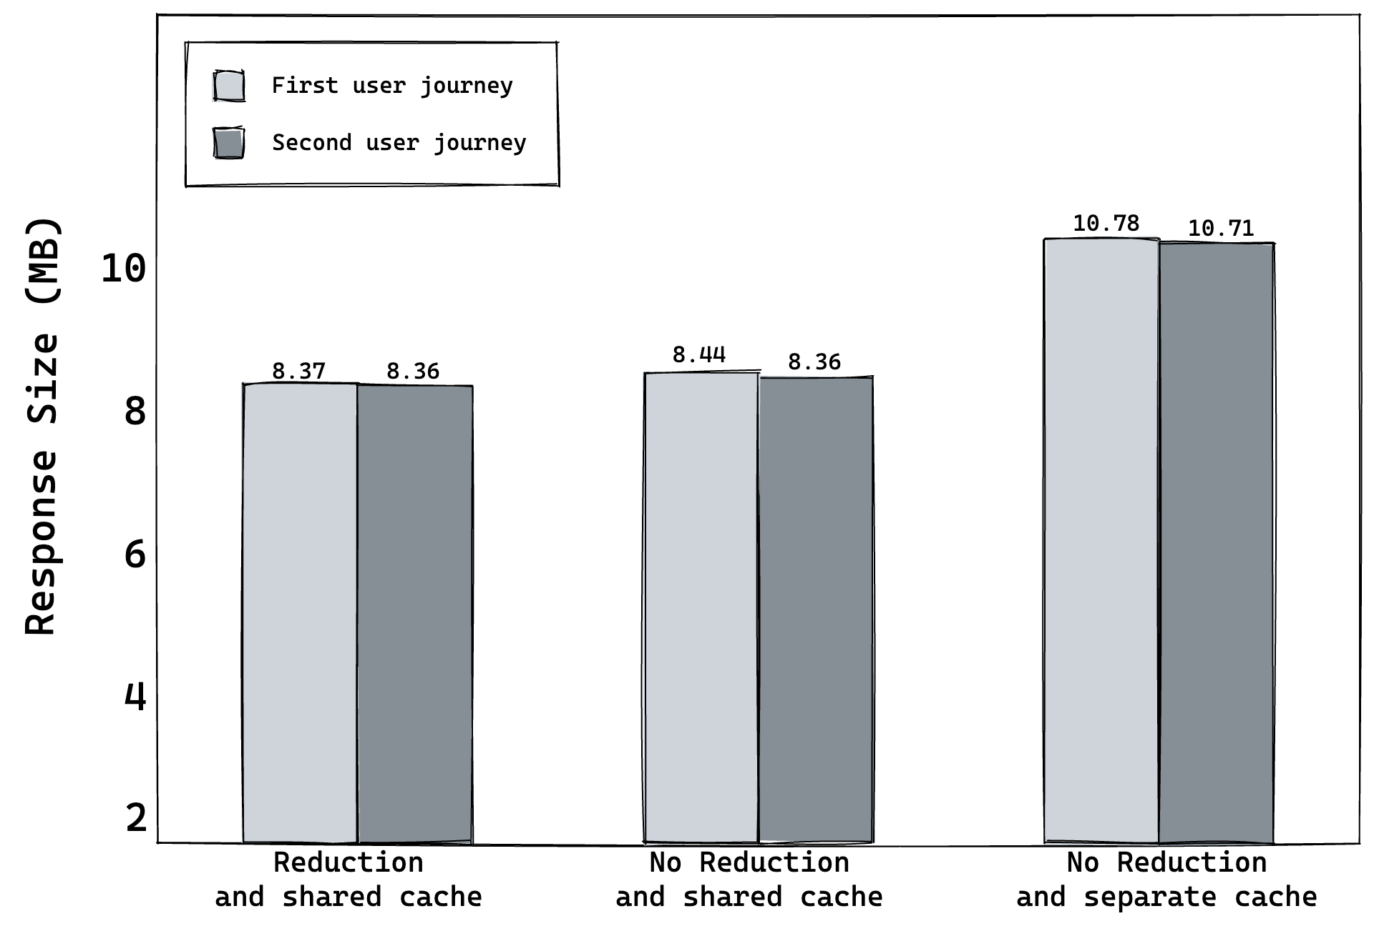
Most significant results: Network response size
Shared caching layer brings great improvements.
Query reduction does not make a significant difference.
1. Approach
3. Approach
2. Approach
36 R
37 R
36 R
37 R
47 R
62 R
Figure 6: Response size comparison between the three approaches.
Notes:
Now, we compare the network response sizes. The results are from the same measurement session.
The shared caching layer brings great performance improvements for the second and third approach. It saves about 2 megabytes of response data, by omitting a lot of requests.
Comparing the second and third approach, again the query reduction does not really reduce the response size. There is only a small, not significant size difference compared to the second approach.
The difference between the second and third are the gains through query reduction.

Slide 14


Summary: Put the results into context
Hypothesis 1: A micro-frontend architecture using a shared GraphQL caching layer with query reduction can solve the problems of over-fetching and over-requesting inside a distributed architecture. The total number of network requests and network traffic can be drastically reduced.
Hypothesis 2: The caching strategy proposed in this thesis is versatile enough to be effectively implemented in various contexts, providing sufficient flexibility to be independent of the technology used.
Notes:
As a summary let's put the results in relation to the hypotheses.
Press
Hypothesis I is partially confirmed. The shared caching layer can drastically reduce the number of requests and network traffic. However, query reduction does not bring a significant improvement to request and response size.
press
Hypothesis II was confirmed. React and Angular micro-frontends could access the shared caching layer. Therefore, the concept of the shared caching layer is technology agnostic. The only requirement is that the framework supports Apollo Client.

Slide 15
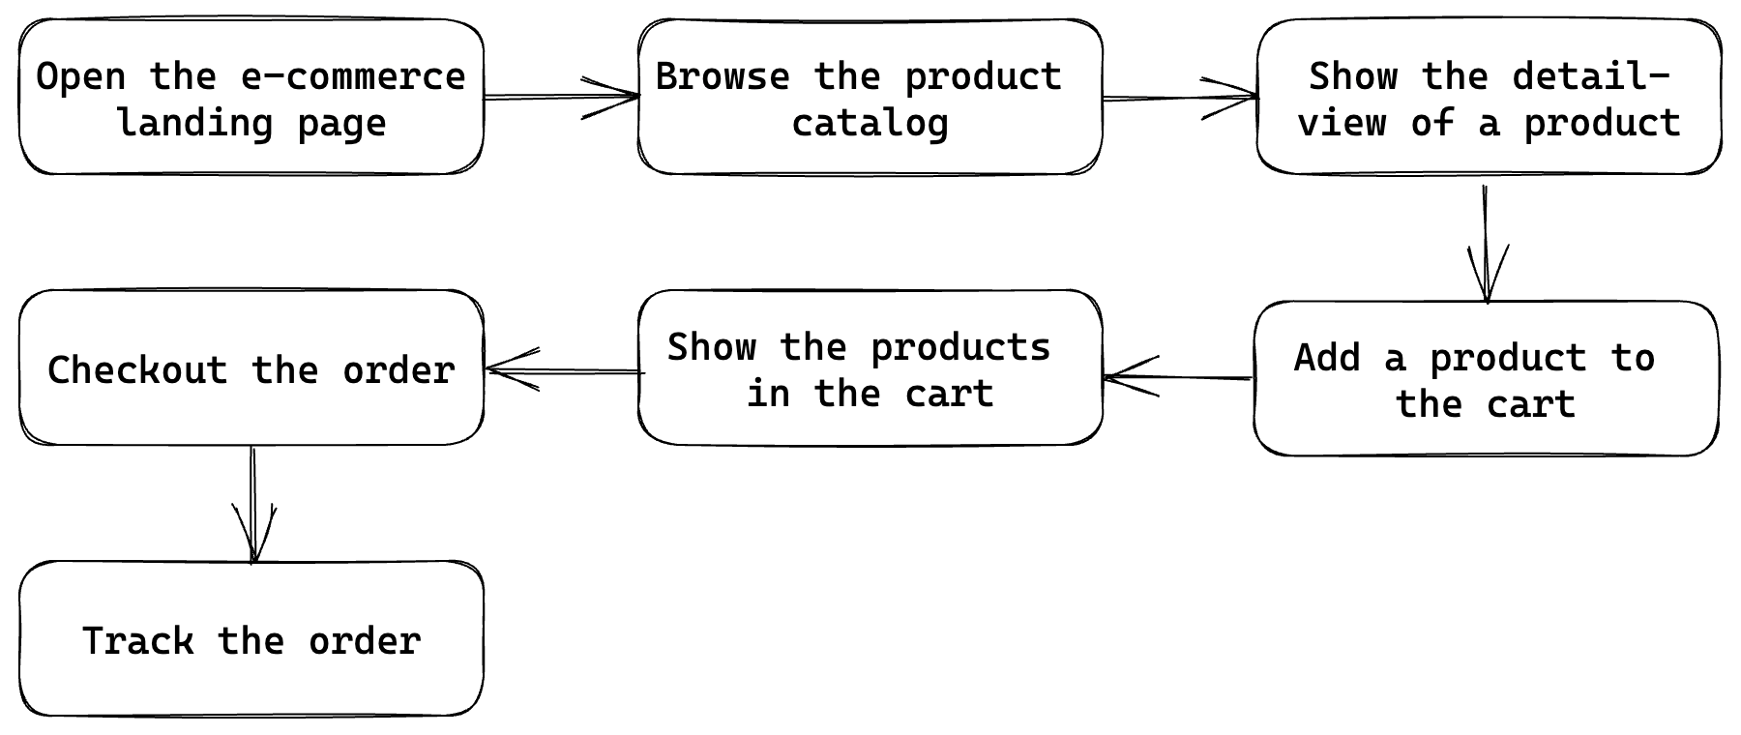
Future aspects
Try query reduction functionality on a different architecture.
Figure 8: A journey through an application that might benefit from query reduction.
Notes:
At the end of this presentation, it is important to consider future aspects.
One aspect would be to use query reduction on a different prototype where it may perform better. In my future work, I discuss an example architecture that could improve its performance by using the query reduction functionality.
This slide shows a figure of a workflow inside that architecture, where query reduction might be beneficial.

Slide 16
Thank you for listening
Mold Florian
Notes:
Thank you for listening.

Slide 17
Sources
Michael Geers. Micro frontends in action. en. Simon and Schuster, 2020. ISBN: 978-161729-687-1.
David Leitner. Micro Frontends. en. 2019. URL: https : / /www.squer. at /en/blog /microfrontend-patterns/backends-for-frontends/
GraphQL / A query language for your API. en. 2023. URL: https://graphql.org/
Forked from https://github.com/appmotion/apollo-augmented-hooks
All technology logos are taken from the official page.
Notes:
For interested listeners I have listed the most important sources.

Slide 18
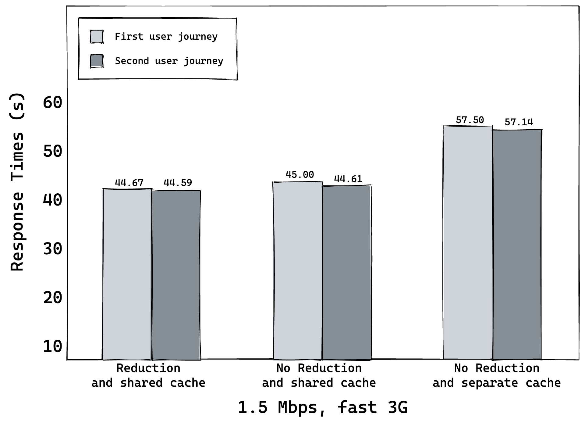
Most significant results: Response times
Measure total download-time for all resources.
Less requests lead to significantly lower response time.
Shared caching layer brings great improvements.
1. Approach
3. Approach
2. Approach
36 R
37 R
36 R
37 R
47 R
62 R
Figure 7: Response time comparison between the three approaches.
Notes:
The network speed was set to 1.5 Mbps to ensure that the network speed stays the same for all three approaches.
The shared caching layer brings about 12 seconds compared to the naïve approach.

Slide 19
Apollo Client’s fetch policies
cache-and-network
cache-first
cache-only
no-cache
network-only
Notes:
cache-first: This fetch policy instructs the Apollo Client to first check the local cache for the query result.
cache-and-network: This fetch policy combines cache-first and network-only policies. Apollo client first checks the cache for the query result and returns it immediately if it is present. Then, a network request is made to fetch the most recent data, which is then used to update the cache. This fetch policy is an optimal choice for presenting data that undergoes frequent updates.
cache-only: This fetch policy instructs the Apollo Client to check only the cache for the query result. If the query result if present, it is returned immediately.
network-only: This fetch policy instructs Apollo Client to skip the cache entirely and always fetch the query result from the server. However, the result is stored inside the cache.
no-cache: This fetch policy skips the cache entirely and always fetches the query result from the server. Unlike network-only, the result is not cached.

Slide 20
Cache invalidation
Polling: Fetch the latest data from the server in an interval.
refetchQueries():
Refetch queries after a mutation.
Update the cache with fresh data
update():
Granular control how the cache is updated after a mutation.
Manually inserting/removing objects into/from the cache.
clearStore():
Clears the entire cache, which invalidates all cached data.
resetStore():
Clears the entire cache and refetches all active queries.
This can be used to ensure that all cached data is invalidated.
Notes:
Polling: Define an interval, in which the query is fetched periodically.
refetchQueries: When mutating data, the mutation allows to refetch specific queries afterwards. This option allows you to specify one or more queries to be refetched after the mutation is completed. By refetching the affected queries, you can update the cache with fresh data and invalidate any outdated information.
update: The update function allows manually modifying the cache after a mutation. For example, i inserted a new record. The mutation inserts it into the cache, but not with in the correct query to be referenced. Therefore, i can insert it into the correct query with the update function and the query reevaluates. Use methods like cache.writeQuery or cache.writeFragment to update specific query results or invalidate data
client.clearStore: Clears the entire cache at once. This method clears the entire cache, effectively invalidating all cached data. Be cautious when using this method, as it removes all cached data.
client.resetStore: This method clears the cache and then re-executes all active queries, refetching the data from the server and updating the cache with fresh information. It can be useful when you want to ensure that all cached data is invalidated and updated.
nextFetchPolicy
QueryName.refetch()
Manual invalidation of fields

Slide 21
Apollo Client garbage collection and eviction
cache.gc():
Remove objects that are not reachable anymore.
cache.retain(objectID: string):
Prevent an object from being garbage collected.
cache.evict({id: string, fieldname: string}):
Remove an object from the cache.
Notes:
Apollo Client offers many methods to interact with its caching mechanism.
Cache.gc(); removes object that are not reachable anymore from the cache.

Slide 22
Consumer Driven APIs & Backend For Frontends
Gives the client exactly the data it needs.
The backend specifies endpoints for every use-case.
Having an endpoint for every requirement creates an unmanageable number of endpoints.
The BFF pattern is frequently used, as it provides every client with its own API.
Notes:
Designing micro-frontends usually comes with the decision to use either generic or consumer-driven APIs. Generic APIs emphasize reusability, while consumer-oriented APIs tailor the APIs to the consumer. The approaches can also be classified as generic APIs and consumer-driven APIs.
Consumer-driven APIs are the opposite of generic APIs. They follow the idea of providing the client with exactly the data it needs. These endpoints make the communication with a client straightforward, and there is no problem of over-fetching and over-requesting. However, creating an endpoint for each use-case creates an unmanageable amount of set of endpoints.
The figure shows an exemplary micro-frontend architecture using the BFF pattern. Each micro-frontend has its own BFF service that fetches data only for that specific client. The BFF work as gateway services to the domain services. This means that the domain services can stay very generic, whereas the BFF services can be very specific. BFFs should only implement the presentation logic that transforms the data into the form that the client requires. It should not store any state.
Persistence logic: Stores and loads data
Domain logic: Calculates, whether a person is allowed to vote (age)
Composition logic: How do components interact with each other
Presentation logic: Bring the data into the shape, as we need it.
The BFF and the frontend application form a single deployment unit, when this architectural approach is used. If on service changes, the others must adapt to the changes. GraphQL is perfect for BFFs, as it is designed for the presentation layer.
BFF make frontend applications more resilient against changes in the domain services, without introducing problems like over-fetching and over-requesting.

Slide 23
GraphQL characteristics
Product-centric
Hierarchical
Strong typing
Introspective
Client-specific queries
Notes:
GraphQL has several design principles:
Hierarchical: Queries are structured hierarchically, allowing the clients to specify what data they need and in what format. This approach enables efficient data retrieval and reduces network overhead.
Product-centric: GraphQL is designed to be product-centric rather than data-centric. That means that developers can create APIs that match the needs of specific products or features rather than being constrained by the limitations of a pre-defined data schema.
Strong-typing: GraphQL is strongly-typed, meaning the data types are defined explicitly in the schema. The typing provides clarity and reduces ambiguity in the API design while also enabling powerful tools for type checking and code generation.
Client-specific queries: In GraphQL, the client specifies the structure of the query rather than the server. This approach allows clients to retrieve only the necessary data, reducing network overhead and enabling faster, more responsive data.
Introspective: GraphQL provides a built-in introspection system that enables clients to query the schema allowing for powerful self documentation and tooling capabilities.

Slide 24
GraphQL subscriptions
GraphQL supports subscriptions.
GraphQL subscriptions are a way to push data from the server to the clients that choose to listen to real time messages from the server.
A result is sent every time, that data is updated on the server.
Polling or manual refetching is often the better way to keep the application up-2-date
Subscriptions are the best option when:
The initial state is large, but the incremental change sets are small. The starting state can be fetched with a query and subsequently updated through a subscription
Low-latency updates in the case of specific events, for example in the case of the chat application where users expect to retrieve new messages in the matter of seconds.
Notes:
Subscriptions can’t use HTTP transport like for queries and mutations. Instead, the subscriptions must communicate over Websockets.

Slide 25
Data normalization
Identify objects
Generate cache IDs
Replace object fields with references
Store normalized objects
Notes:
The Apollo Client normalizes and stores the data inside the cache. The data is stored in a normalized way to avoid duplication. The cache is a simple JavaScript object. The objects inside the cache correspond to objects that are returned by GraphQL queries. The cache is a flat lookup table of objects that reference each other. An empty cache is just an empty JS object. A single cached object could include fields, that are fetched by different queries.
The data-normalization process has four steps that are explained in more detail in the next slides.

Slide 26
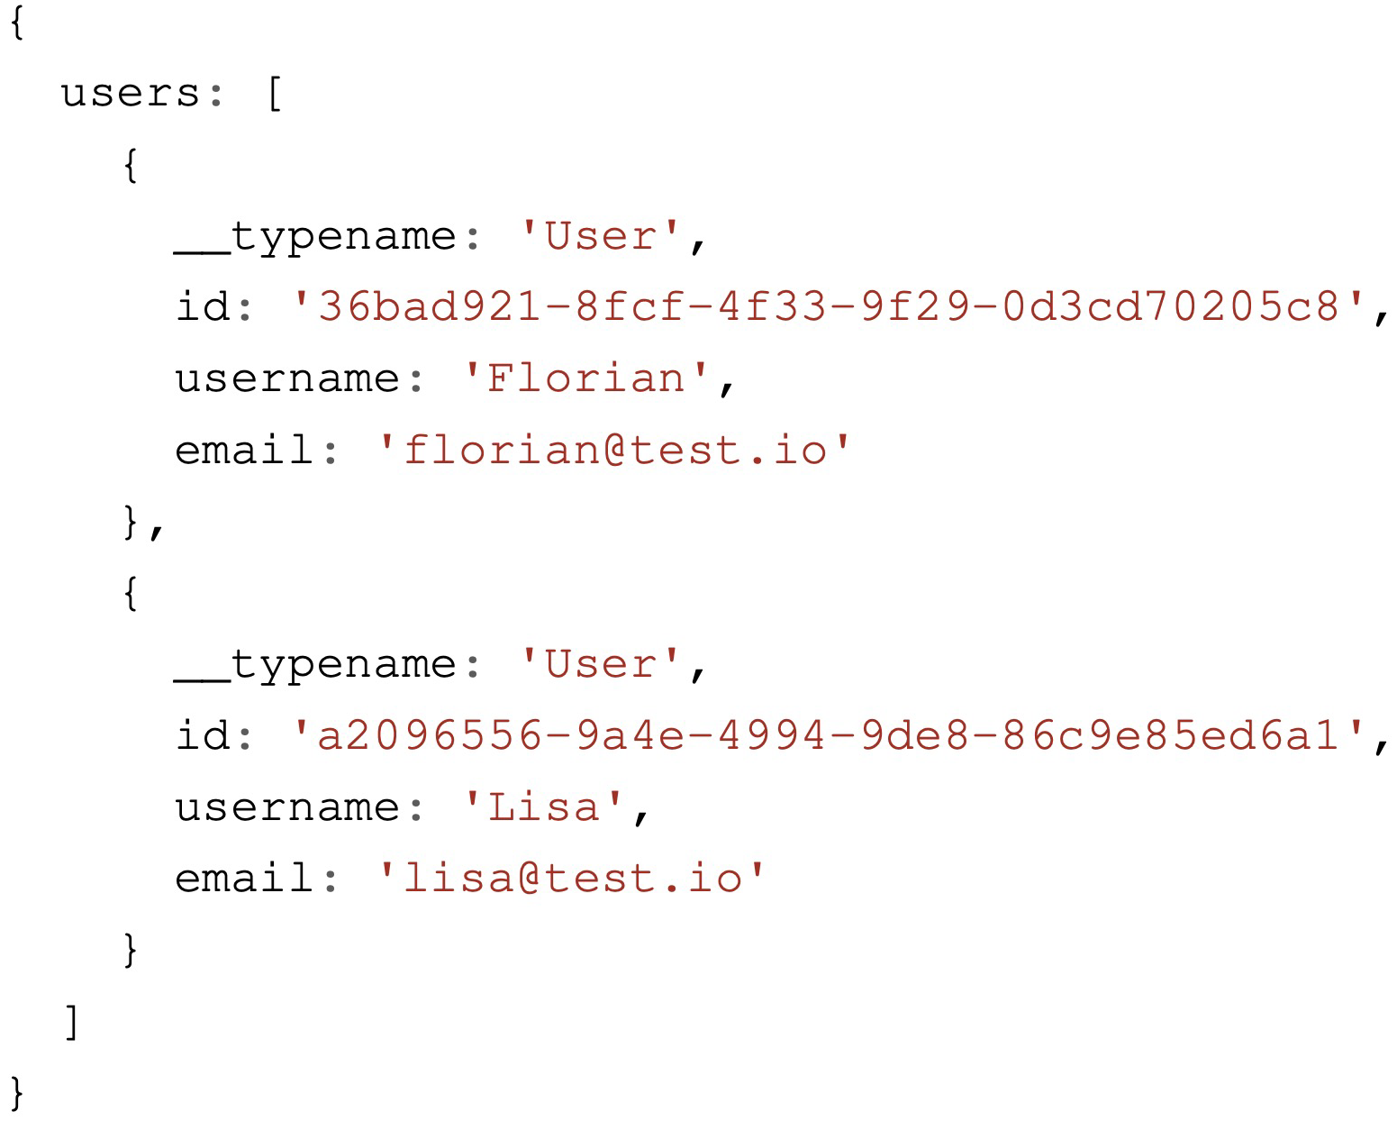
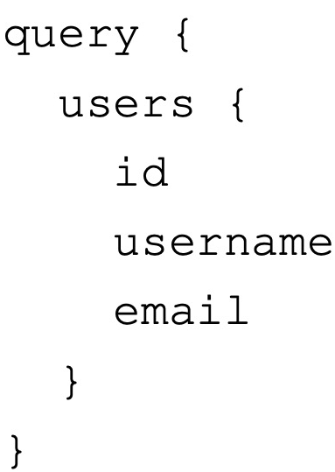
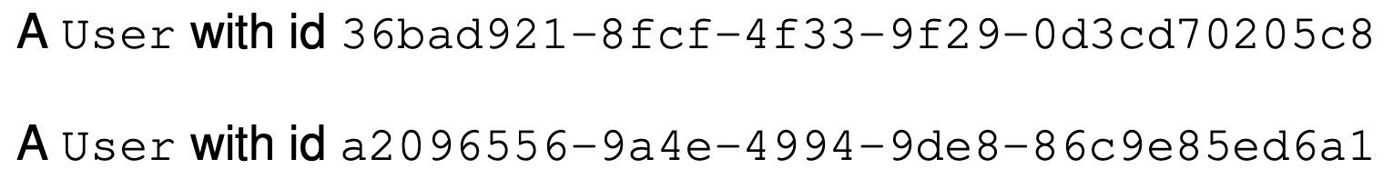
Data normalization
Identify objects
Response
Notes:
The cache identifies all objects that are identified inside the query response. Take the query on the slide, which requests all users with their id, username and email. The server responses with the objects that are shown on the slides.
The __typename property is automatically appended to the query by the Apollo Client, to identify which type the object has. The response contains two objects, the caching mechanism identifies two objects to be cached.
The cache identifies two objects user objects.

Slide 27
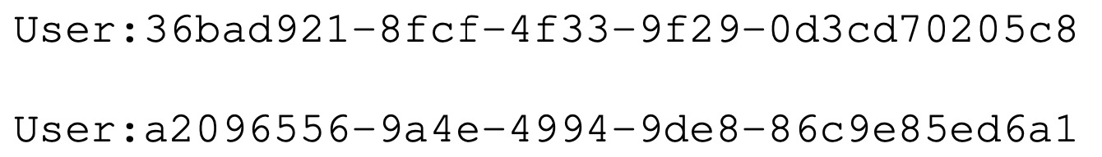
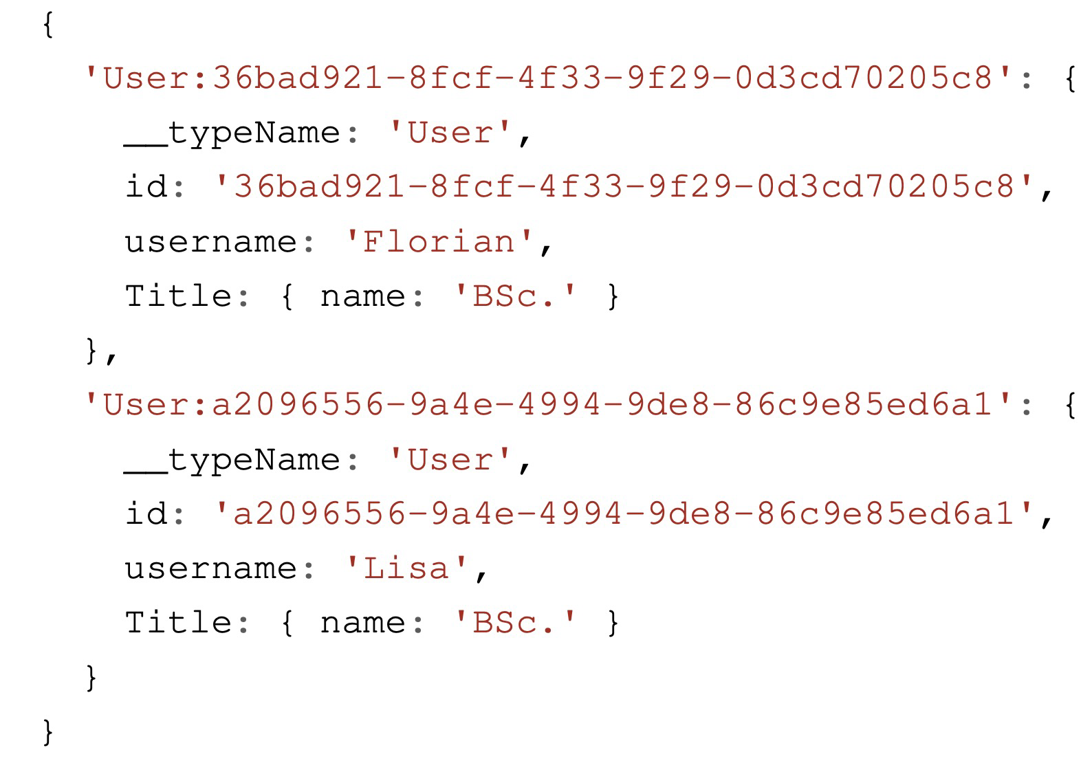
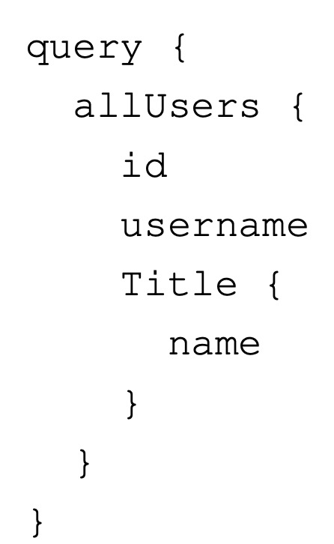
Data normalization
Identify objects
Generate cache IDs
Response
Notes:
After all objects that should be cached are identified, the caching system generates a unique identifier for each object. This id is needed to identify the objects inside the cache. The cache IDs of the objects from the previous slide are shown on the slide.
The default mechanism to generate cache IDs is to concatenating the objects __typename and the id field. If the caching system is unable to generate a cache ID for an object, that object is stored directly within its parent. As a result the object must be accessed and referenced through its parent. This leads to the consequence that the cache is not always completely flat.
An example is shown on the slides of this behavior. The id of the title is not queried. Omitting object ids from the cache should be avoided. Every occurrence of the cache has to be updated, if the object is stored within its parent object. It should be avoided that an object is sometime queried with and without, as this introduces weird behavior.

Slide 28
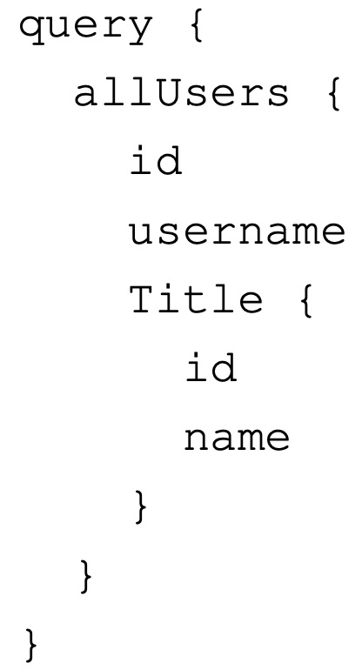
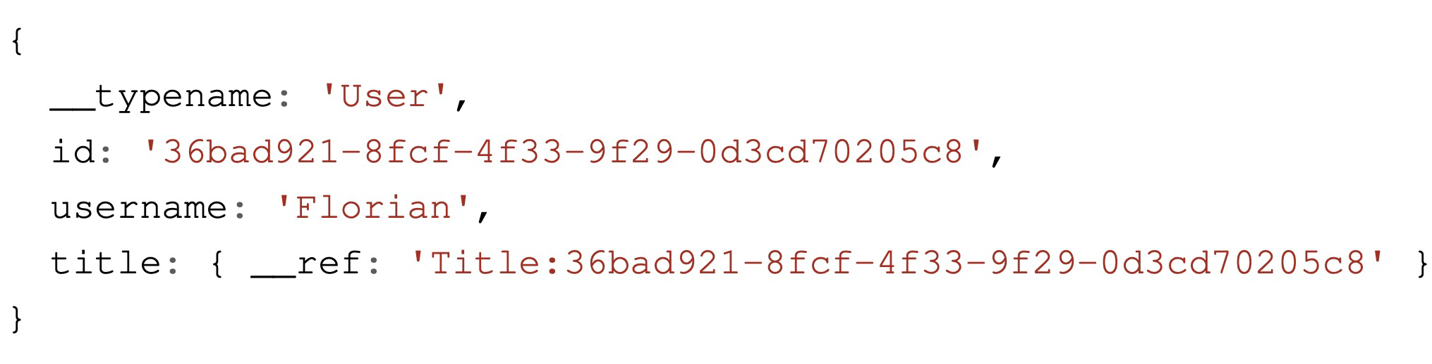
Data normalization
Identify objects
Generate cache IDs
Replace object fields with references
Cache
Notes:
After identifying all objects that should be cached, the caching system replaces the values of each field that contains an object with a reference to the corresponding object. The title references another object inside the cache. By using normalization, the amount of duplicate data stored in the cache can be significantly reduced. Normalization helps to stay in sync with the servers data.

Slide 29
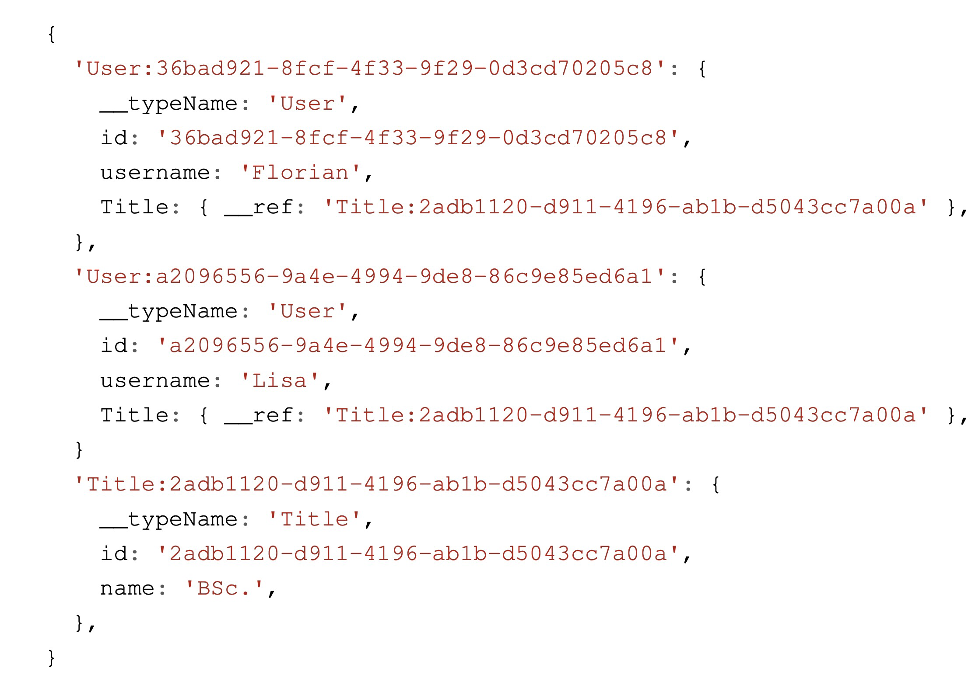
Data normalization
Identify objects
Generate cache IDs
Replace object fields with references
Store normalized objects
Notes:
When an incoming object shares the same cache ID as an already existing object, the two objects are merged. The incoming values will overwrite the existing values. Any fields that are in only one of the two objects will be preserved. This process of normalization creates a partial copy of the data graph on the client.
The figure on the slide shows a complete normalized cache. Each user contains a reference to the same title. Therefore, both users have the same title. The GraphQL API returned the same title for both users. However with the cache normalization, the title is present only once in the cache. This behavior is helpful, because, when a cache item is updated, the cache does not have to be traversed fully, if an instance had changed. Only a single item has to be changed. The normalization only works when the result has an id field.

Slide 30
Query Reduction
Apollo Client does not provide this feature out of the box.
Identical queries that fetch different fields, are always fetched from the server.
Notes:
The next step to optimizing performance was to optimize the use of the in-memory cache. The size of the network responses can be reduced, by removing fields from a query. Apollo/Client does not offer this feature out of the box, so it was implemented as part of this thesis. The most important parts of a query are the name and the parameters. Only if the same query is executed again with the same parameters and the same fields, the results can be used from the cache. If the query tries to fetch fields, that are not inside the cache, the query is sent to the GraphQL API. Identical queries that fetch slightly different fields are always fetched from the GraphQL API.
Consider the figure on the slides, both queries fetch the same GraphQL type and the same fields. Both queries are sent to the server, because they are different queries. They have different names and parameters. Both queries are sent to the GraphQL API. If the left query is executed before the right query, the user from the right query could be taken from the cache. This problem can be solved through Apollo Client alone. Apollo Client can be configured to find the data that is requested with the user query using cache redirects. Therefore, a read policy has to be written to point Apollo Client into the direction, where the user is being located.
Using cache redirects to reduce the number of network requests works, but all requested fields of the query must be already inside the cache. If the user query might query a field that the allUsers query didn’t the query would result in a cache miss, although just one field is missing. The fact that a table-view and a detail view are completely identical is quite rare in applications. This approach is not scalable, as these type redirects would have to be written for every type.

Slide 31
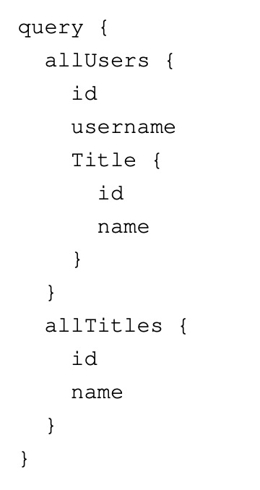
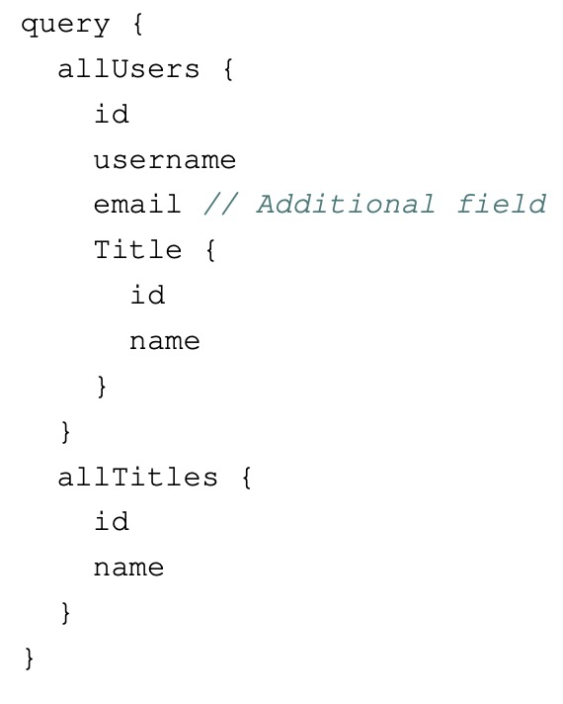
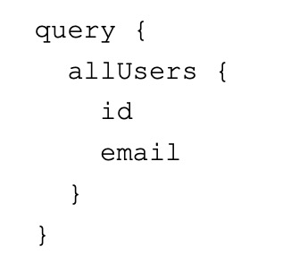
Query reduction
First query
Second query
Reduced query
Reduction
Notes:
In large applications, it is likely that the same query is executed repeatedly. Apollo Client will always fetch the query from the server, unless the selection set is identical or all fields are already cached.. It ignores the fact that many fields that are needed are already inside the cache.
The first time the query is executed, a request to the server is sent. Each subsequent execution of the query with the same selection is served from the cache and a roundtrip is saved.
Afterwards the same query with an additional field is sent to the server, the query is executed completely against the server. The queries are almost identical, the query will result in a cache miss. The better approach would be to fetch only the fields, which are missing inside the cache, which is the email in this case.
The id cannot be removed, because it is needed to merge the incoming with the existing data.

Slide 32
apollo-augmented-hooks
Provides drop-in replacements for Apollo Client’s query and mutate functions.
It implements the functionality to remove fields from queries that are already inside the cache.
The dependencies of the library are outdated
Specifically developed for React.
Fork the library and make it technology agnostic.
Rewritten with typescript

Slide 33
Remove fields from queries
Identify key-fields
Retrieve cache references from the in-memory cache.
Reduce the cached data
Fetch the results
Notes:
This section should describe shortly how the reduction of queries works. Apollo Client allows the user to specify multiple configuration options for a query. The three most important options are the variables, query and the fetch policy. The query specifies the GraphQL query to execute and the variables are for the query. The fetch policy specifies how data is stored and retrieved from the cache.
The four steps to remove fields from a query are shown on the slide.

Slide 34
Pre-conditions
Query reduction just works with cache-first fetch policy
Queries with polling are not supported.
Notes:
Reducing a query with the fetch-policy: cache-only, network-only and no-cache is counterproductive. Network-only just fetches the latest data from the API, whereas cache-only just targets the cache. No-cache also fetches just from the network. Using polling also omits the use of query reduction.

Slide 35
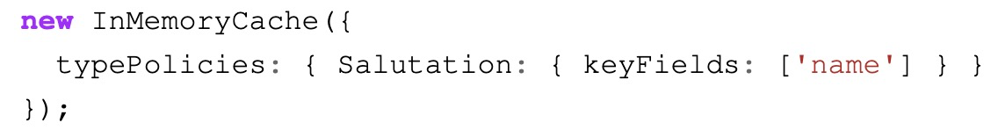
Remove fields from queries
Identify key-fields
If no custom key-field is specified id is assumed.
Key-fields can’t be reduced, because they are needed to identify the object inside the cache.
They are also needed to merge incoming and existing values in the cache.
Notes:
The first step of query reduction is to identify the key-fields of every type in the GraphQL schema. The key-fields of each type can be read from the in-memory cache. The contents of the cache can be extracted programmatically. For better availability, the key of the object is the name of the type and the value are the key fields. By default, the id field is the key-field of every type. But the key fields of every type can be customized inside the in-memory cache’s configuration, like shown on the slide.
Each field is checked, if it is a keyfield. The __typename is used from the cache object.
The in-memory cache uses the id or _id to generate the unique id for a cache object.
As seen on the slide the key fields can be customized for each type individually. Query reduction can’t remove key fields of a GraphQL type, because they are unique identifiers of the object entry inside the cache. Apollo needs the unique id to merge incoming and existing data inside the cache.

Slide 36
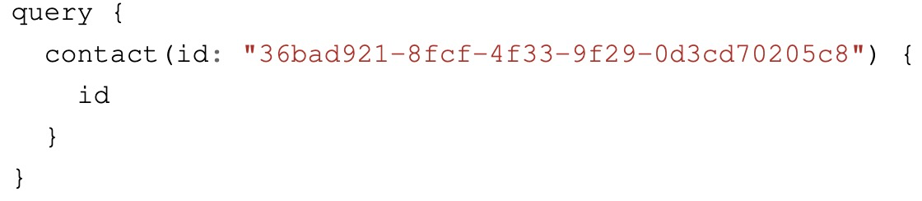
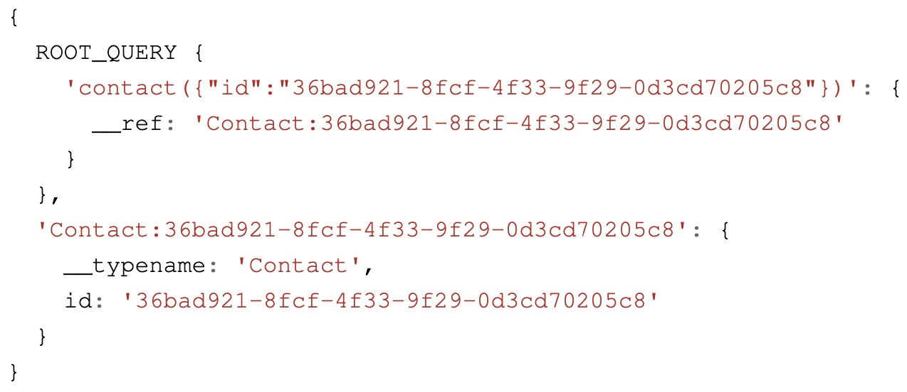
Remove fields from queries
Identify key-fields
Retrieve cache references from the in-memory cache.
Notes:
After retrieving the key-fields for every GraphQL type, the selected fields of the query are iterated.
The outer selected fields of the query on the slide are the allSalutations and allTitles. The outer names inside the queries selections are the names of the queries. To check whether the query was executed before, the name of the query inside the cache’s ROOT_QUERY must be determined. By default, the cache entry identifier consists of the query name concatenated with the query parameters. The parameters of the query are converted to a stringified object, that has the structure as seen in the slide. The entry for the query can be seen in the slide in the ROOT_QUERY section. If the query is executed with another id, there would be another cache entry.
The slide shows an example of a GraphQL query that is converted to a ROOT_QUERY entry.
For the query reduction functionality to check whether the query was executed before, it must be put into the form, how the Apollo Client stores in the ROOT_QUERY it. If no arguments are present, the Apollo Client stores the name of the client as is (without ()). Therefore, the name of the query is concatenated with the parameters.

Slide 37
Remove fields from queries
Identify key-fields
Retrieve cache references from the in-memory cache.
Reduce the cached data
The cache reference is used to check, whether all required fields are in the in-memory cache.
The cache reference is used to remove fields from the query.
Notes:
After the unique cache key of a query has been determined, it has to be checked, whether the ROOT_QUERY contains the key. The contents of the ROOT_QUERY can be accessed programmatically like shown on the slide. If the result of the access is undefined, the query was not previously cached and must be fully executed against the API. If the query was executed before, a reference to the objects inside the cache is returned. The references are used to check whether the objects in the cache contain the fields want to query. And it is used to remove the fields from the query. When a list of references, all references must contain the field, otherwise it must be queried.

Slide 38
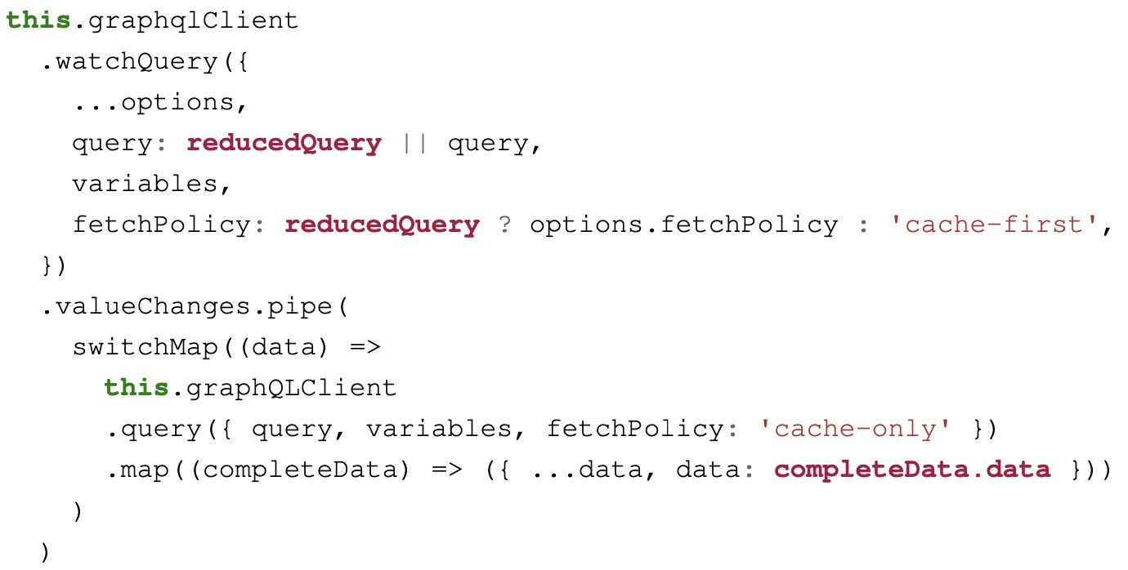
Remove fields from queries
Identify key-fields
Retrieve cache references from the in-memory cache.
Reduce the cached data
Fetch the results
Notes:
After the fields are removed from the query, the reduced query is executed against the GraphQL API. The original query is executed against the cache with the fetch-policy cache only, to get the data, which is already inside the cache. Both query results are merged to a single object. If a query can’t be reduced, the original query is executed against the cache. Or if all fields are removed, the original query is executed against the cache.

Slide 39
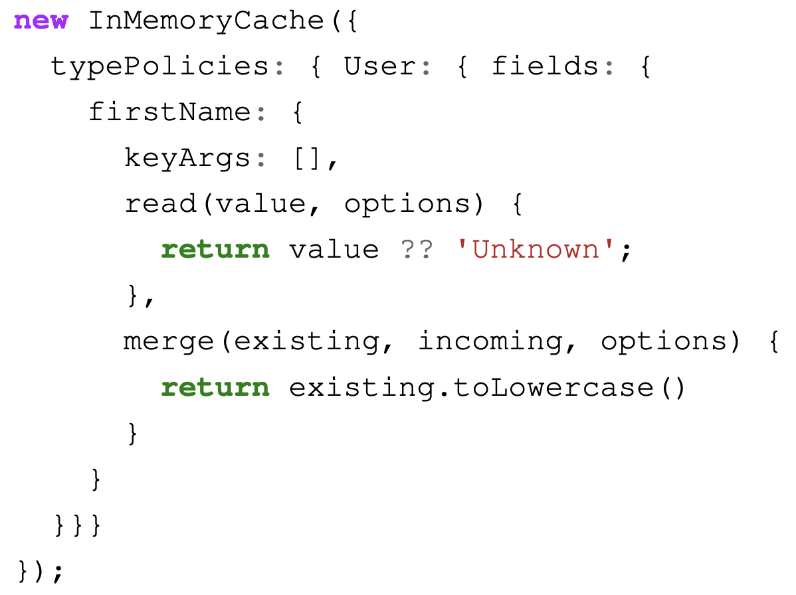
Type Policies
Type policies define how the client stores and manages data.
A field policy consists of:
read function
merge function
keyArgs (key arguments)
Notes:
Type policies define how the client stores and manages data in the cache. The constructor of the in-memory cache accepts the configuration for type-policies as an object. The behavior of the cache can be configured on a type-by-type basis. Type policies allow to customize how a particular field is read and written. Each field can be customized individually.
A field policy consists of:
Read function, which is called, when the field is read from the cache
Merge function, which is called, when the field written to the cache.
The key-arguments of the query. These avoid storing duplicate data in the cache.

Slide 40
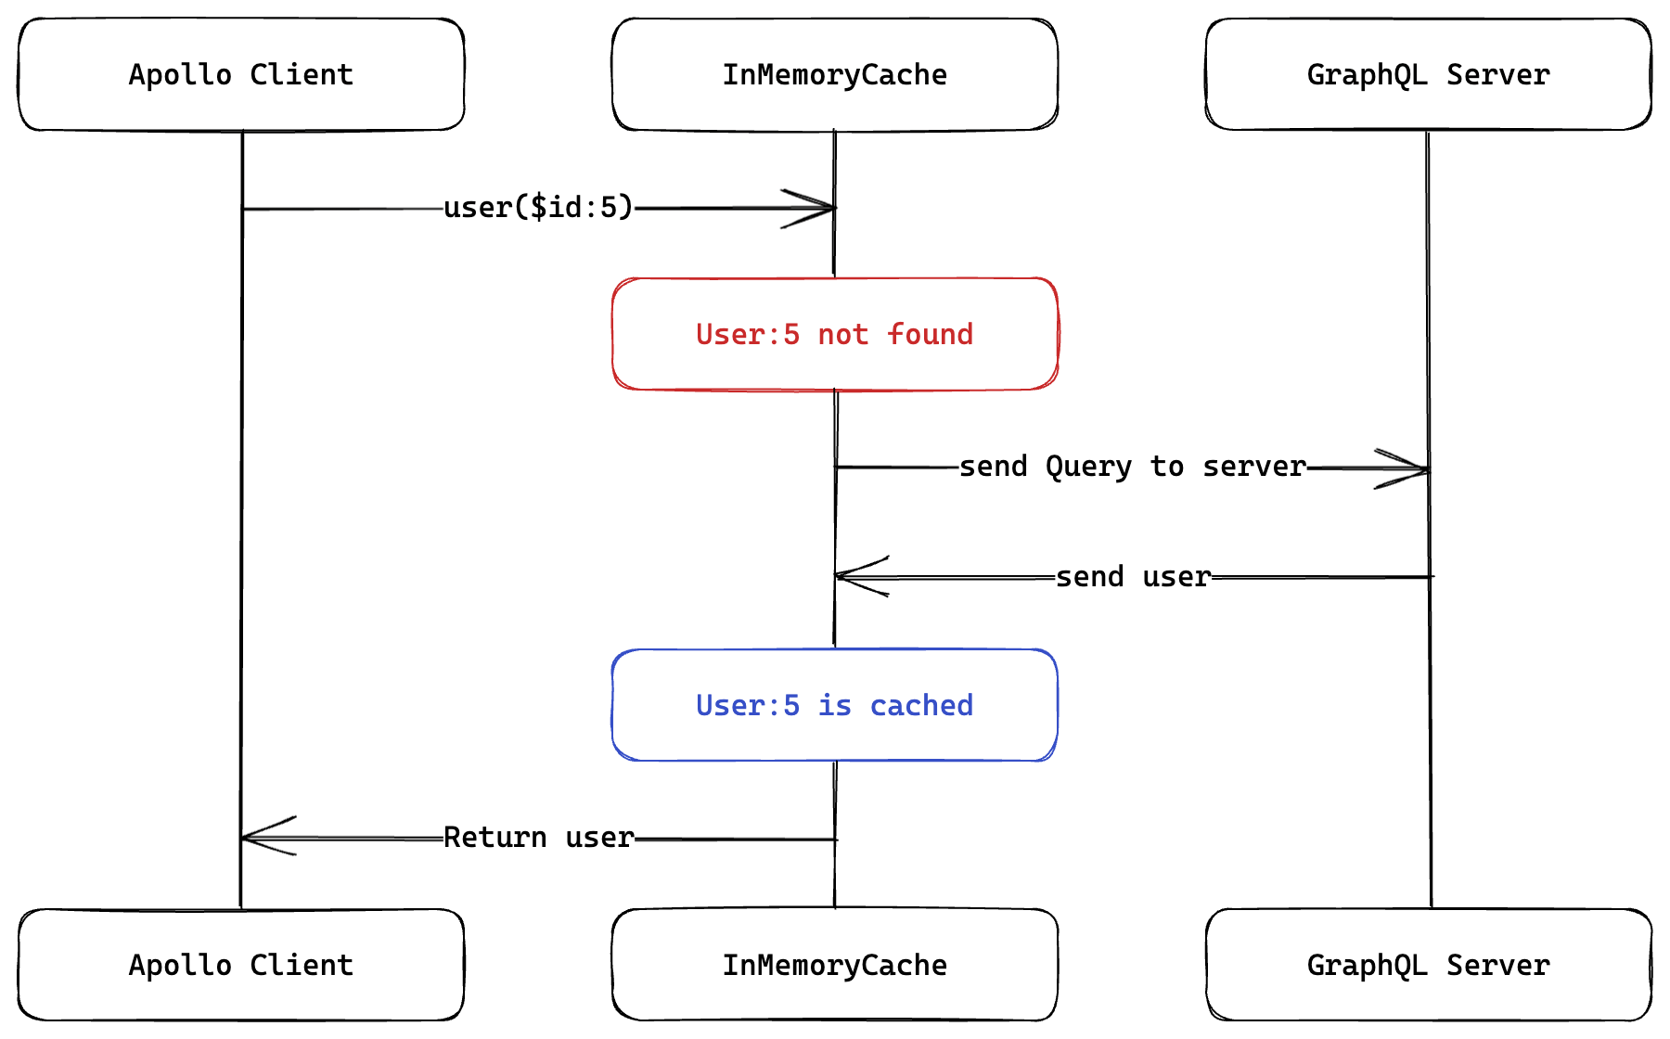
Apollo Client Cache Structure
All GraphQL queries with Apollo Client are cached by default.
Reduces roundtrips to the server.
Notes:
The in-memory cache is a local, normalized, in-memory cache. The requests are stored within the browsers memory.
By utilizing the cache, the Apollo Client can quickly respond to queries for data that has already been cached. The mechanism is used to reduce the round-trips to the server, because the data can be served from the cache.
The figure on the slide shows an example of a user that is fetched. First the Apollo Client checks whether the user with the given id has already been stored in the cache. If the query with that id has yet to be executed, a network query to fetch the user must be made. The result from the GraphQL Server is stored inside the cache and the user is returned to the application. The cache has a flat datastructure.

Slide 41
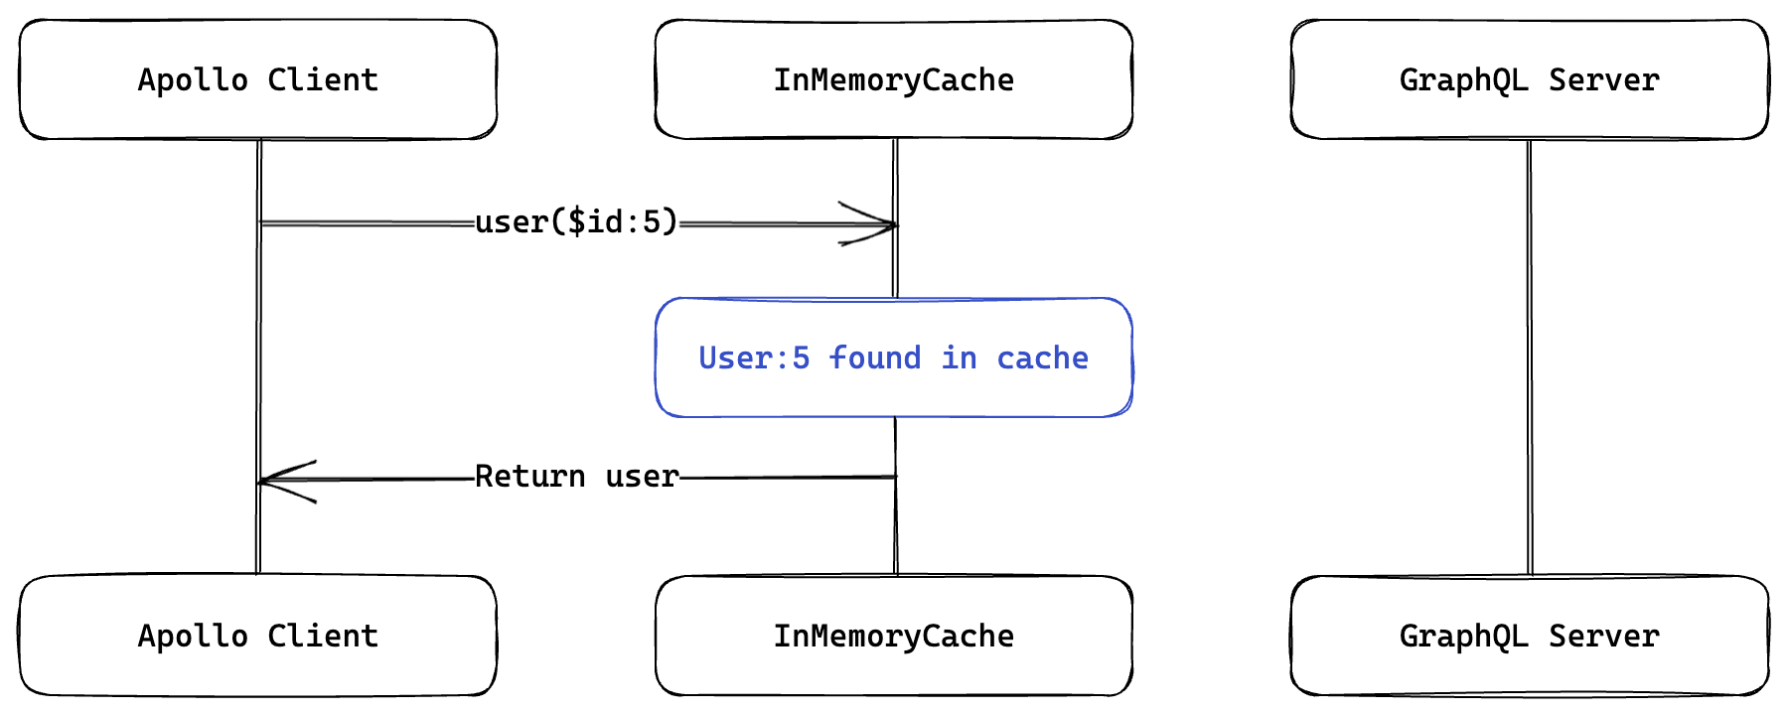
Request with cached query results
Notes:
If a request with the same user id is made again, the flow looks like in the Figure on the slide. As seen in the slide no request must be made to the GraphQL API, because the data is served from the cache directly. The data is served in two steps.

Slide 42
API Abstraction
Microservices offer fine-grained interfaces.
Clients should not communicate with microservice APIs directly.
Multiple requests are needed to fetch the desired data.
Microservices could use another form of communication protocol, which is supported on the frontend.
gRPC, Message Bus, ...
Changing the API of a microservice might have a ripple effect.
API gateways are an abstraction layer for microservice APIs.
Every frontend has its own Backend-For-Frontend.
Notes:
Every microservice provides its functionality to consumers with APIs. It is not advisable that clients directly communicate with microservice APIs. Microservice offer fine-grained interfaces which were made especially for the communication between microservices. Therefore, the client usually must make multiple requests to fetch and aggregate the data to display a page inside an application. This leads to a lot of requests, also known as over-requesting and over-fetching, which harms the user experience.
Another problem with integration is that microservices might use another form of communication, which is not supported on the frontend. For example gRPC, which is not supported on the frontend. Clients usually communicate with synchronous communication.
But the client needs to know a lot of internal details about the microservice cluster. Changing the API of a microservice would have a ripple effect on the requests of the frontend because they would have to be adapted to the changes in many places.
The solution is that clients should communicate with an API gateway or a more client-centric BFF service. API gateways serve as an abstraction layer for microservice APIs, serving as the entry point for a system that consists of multiple microservices.
Gateways forward requests to the correct microservice. They might implement functionalities like authorization and authentication, transforming the communication protocol. With the help of API-gateways it is easier to move the functionality of a micro-frontend to another, without having to change all micro-frontends that consume the functionality. Just the backend-for-frontend has to be changed.
One problem with API gateways is the ownership. Multiple teams add their functionality to the gateway and might come into conflict. They might implement functionalities like authorization and authentication or transformation of the communication protocol. It must be avoided that business logic is put into the API gateway. Another pattern to bypass the problems of API gateway is the BFF pattern.

Slide 43
Enhanced features of apollo-augmented-hooks
Add functionality to apollo-augmented-hooks
Add support for custom key-arguments
Add support for cache-redirects
Add support for parameter-less queries

Slide 44
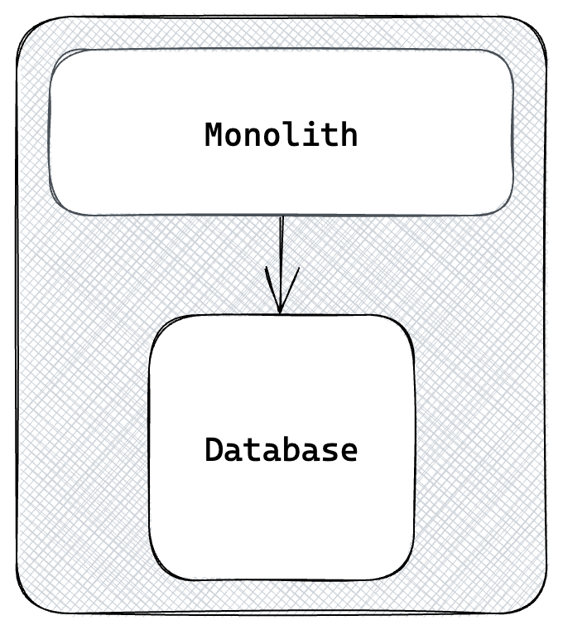
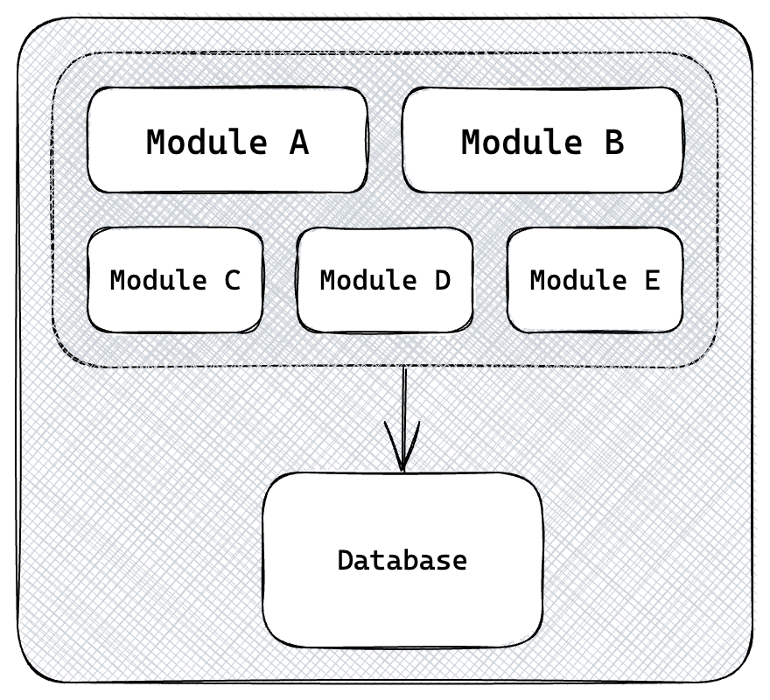
Software Monoliths
A single code- and database.
Monolithic architectures are not legacy architectures
A modularized software monolith.
Notes:
A monolithic architecture is characterized by the fact that there is only one single codebase. Many developers, regardless of which team, are working on the same application. A single application provides the advantage of having a complete overview of the application. A typical monolithic application is shown on figure in the slide.
Refactoring the codebase is easier, if changes can be applied across the complete project is possible. All changed parts can be directly regression tested by running the application and the related database. The whole application can be built and deployed in one step.
If the monolith starts to grow, it is important to have a good software architecture. The code should be modularized and follow the rules of high cohesion and low coupling of source code. Modularization splits the application into multiple parts, making it easier to understand, while the application still is a single process. The application must be deployed as a single unit. But a database can’t be composed into smaller units.
A monolithic architecture is not synonymous with legacy applications. A monolith is a good starting point for new applications, if the domain of the application needs better understanding. It is easier to understand the inner-workings of the application and make changes.

Slide 45
Software monoliths disadvantages
Large codebases increase the complexity of the project.
Program comprehension is an essential factor in software maintenance.
Multiple teams work on the same chunks of code.
Confused lines of ownership
Restrict available technologies.
Notes:
Having a single large codebase increases the complexity. Each new feature adds a new complexity level, which leads to reduced developer performance. It takes a long time to understand the source code, before being able to develop a new feature. Program comprehension is an essential factor in software maintenance. Without program comprehension, developers might create unwanted side effects, when trying to fix a bug.
A big problem is that multiple developers might work on the same chunks of code. Two different developers might need to make a change to code in a shared library. The change might be not coordinated with the other developers, which leads to unexpected behavior in the code of the other developer. The circumstance is also known as confused lines of ownership, which are frequent sources of errors in a software system.
The use of a monolith limits the choice of technology. The technology stack is restricted for the entire lifetime of the application. Technology becomes obsolete at one point. Applications based on such technologies must be rewritten completely.

Slide 46
Micro-frontend architecture
Bring advantages of microservices to the frontend.
Independent development and deployment.
Notes:
Micro-frontends should bring the same advantages of microservices to the frontend. Instead of creating a giant frontend monolith, a micro-frontend contains many small applications. The advantages is that every micro-frontend can be developed independently.
The differences of micro-frontend architectures in comparison to traditional frontend monoliths can be seen on the slide. Every team that owns a domain creates their own application and implements every layer vertically. Each team can choose its technology stack individually.
The advantages of microservices are lost, when having a monolithical micro-frontend approach. A single new feature can’t be deployed on the frontend, as the complete monolith has to be deployed. Distinct Operations won’t work, as if one part of the application breaks, there is a good chance that the complete application won’t work. Speeding up the development will also not work, as it is difficult that multiple teams work on a single micro-frontend.
The term micro-frontend can be misleading, just like the term microservices. It does not indicate the size of the service. The micro-frontend can be a simple widget or full-blown SPA. In an ideal scenario a micro-frontend should cover a section or a part of an entire application.
A problem of micro-frontends is that they should look like a single coherent application to the user. Therefore, the micro-frontends need some kind of integration strategy.

Slide 47
Micro-frontend characteristics
Technology agnostic
Autonomous
Independent deployable
Resilience
Small and easy to maintain
Notes:
Micro-frontends try to follow the same principles as microservices. They have five characteristics.
Autonomous: Entirely independent runnable application. The integration happens through the frontend. The micro-frontends are combined with the help of an application shell. The application shell is the entry point to the application. The application shell defines the layout of the application. No dependencies between the micro-frontends should emerge, as they could harm autonomy.
Technology agnostic: Micro-frontend architectures can be technology agnostic. The advantage of micro-frontend architectures is that every application could be written in another technology. But different technology might lead to integration and communication problems. Therefore, the communication should be technology agnostic with tools like the Broadcast Channel API.
Independently deployable: The autonomy of micro-frontends offers the possibility of independent deployments. A sizeable monolithic frontend application is complex to deploy, and there is less to no need for communication and coordination over multiple teams to deploy the application. Inter-team Dependencies have a negative effect on the time-2-market, as teams may have to wait for another team’s release.
Small and easy to maintain: Because micro-frontends only contain a small part of the functionality of an application, the source code is smaller and easier to understand. A smaller codebase is helpful for understanding the inner workings of an application. Onboarding new team-members is also easier, because the code-base is smaller and focused on one domain. And because it is smaller it can be rewritten more easily.
Resilience: Micro-frontends offer the possibility to build large applications by composing multiple small applications. A micro-frontend architecture provides better failure isolation, as the failure of one micro-frontend does not affect the whole applications. Some parts of the application might not work, but other parts of the micro-frontend architecture are still useable. The application shell can show the end user, which part of the application does not work and that it will be available soon after.

Slide 48
Micro-frontend disadvantages
Redundancies
Infrastructure complexity
Free choice of technology comes with downsides.
Backward-compatibility
Bundle-size
Consistent look and feel
Over-fetching, Over-requesting
Notes:
Having multiple teams develop software at the same time introduces redundancies in the code. A critical aspect of software engineering is to eliminate redundancies in the code. This might introduce much redundancy in the form of duplicate code. In frontend terms, this might introduce duplicate styles and components. That should be handled with a UI component library.
The infrastructure complexity increases with micro-frontends and BFF as many more services need to be deployed. The number of services doubles, if the BFF pattern is used.
It is essential to share knowledge between the teams to avoid fixing the same bugs over-and-over again.
The free choice of technology also comes with downsides, as it is harder for developers to switch teams. Another pain-point of micro-frontend architectures is to keep backward combability. Different micro-frontends might have different dependencies, versions and interfaces.
Another problem might be the bundle size. If multiple frameworks are used, the bundle size might get extra large. Maintaining a consistent look and feel across different components can require a lot of effort.
A problem addressed in this thesis is the over-fetching and over-requesting of resources. A micro-frontend might make more requests than actually needed and a micro-frontend might need to make multiple requests to get the required data. A problem specific to micro-frontends is that they might make the same network requests to the BFF, loading to a higher load.

Slide 49
Micro-frontend integration strategies
Client-Side integration
Server-Side integration
Notes:
Server-Side Integration
A service sits between the client and server and does the composition.
The server responds with a html template, which references the micro-frontends that should be included and the required assets.
The service in the middle intercepts the response from the server and replaces the references to the micro-frontends with their actual content.
Better initial page-load performance (The browser fetches the complete html page)
The computation is done on the server, which reduces strain for the users device.
However, assets like stylesheets and images must still be fetched from the server
Server Side integration is helpful if the application’s primary goal is presenting static content to the end user and if an instant reaction to user’s inputs is not necessary.
Client-Side Integration
Preferrable, if the application should respond immediately to user’s inputs.
The user should be able to add items to a cart, without making a roundtrip to the server.
The user should think that he interacts with only one application.
The HTML markup of modern JS Frameworks is produced on the client-side
Integration can be achieved via Hyper-links, combine them with JS (Module Federation)
No page reloads are necessary, when switch a page.
The approach used in the thesis is Module Federation
Build-time integration, run-time-integration, server side integration

Slide 50
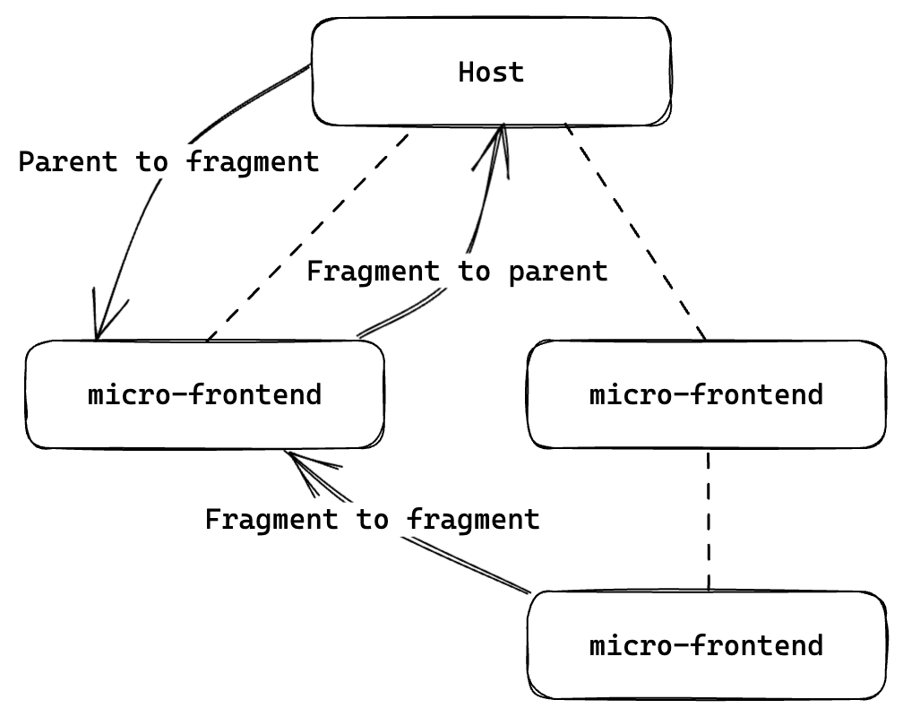
Micro-frontend communication
Notes:
Micro-frontends should not directly depend on each other, but they should have communication between them. But the communication should be kept at a minimum. Before choosing a communication pattern, it it necessary to know the type of communication. If the micro-frontends are integrated using hyperlinks, the communication can happen only via URL parameters, because each application has it own context.
SPAs usually communication via custom events or attribute changes.
It can be distinguished between parent-to-fragment, fragment-to-parent or fragment-to-fragment communication, where the term parent refers to the application shell and the term fragment refers to the micro-frontend.

Slide 51
Micro-frontend communication
Orchestration via a parent
Direct communication
Event-Bus/Broadcasting
Notes:
Parent-to-fragment communication can happen through attribute changes, if custom elements are used. To send data from a micro-frontend to the parent, custom events of html can be used, where the application shell has a listener registered.
Fragment-to-fragment communication is required if two micro-frontends should communication with each other. The change from one micro-frontend should affect the other as well. It can be implemented in three ways.
Direct communication:
Most direct form of communication. One micro-frontend changes the attributes of another micro-frontend with JS. It introduces tight coupling between the micro-frontends. The micro-frontends need implementation details of each other to perform the communication. This type of communication violates the micro-frontend characteristics, which are independent and autonomous development.
Orchestration via parent:
The application shell is responsible for communicating between micro-frontends. One micro-frontend sends an event, which is intercepted by the application shell. The application shell forwards the event to the target micro-frontend. This allows the micro-frontends to be completely decoupled.
Event-Bus/Broadcasting:
The micro-frontend can publish events to an event-bus. The other micro-frontends can subscribe to the events and react accordingly. This pattern is described as publish/subscribe pattern, drastically reducing the tight coupling between multiple micro-frontends. The micro-frontends do not need implementation details of the other micro-frontends.

Slide 52
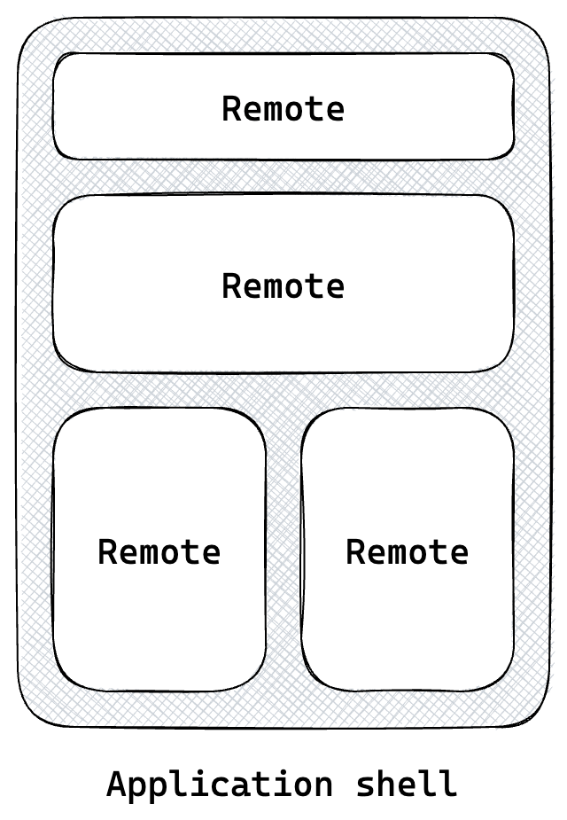
Module Federation
Consists of a
Host: Fetch & display the micro-frontends.
Remote: Consumable by the host.
Share dependencies across micro-frontends
Server-side rendering is supported.
Modules can be imported dynamically.
Unidirectional interaction from the host to the micro-frontend is encouraged.
Notes:
Module Federation is a native plugin for Webpack 5. Module Federation allows chunks of JS code be loaded synchronously or asynchronously during runtime. Lazy loading the JS chunks takes place in the background.
A module Federation application typically consists of two parts:
The host, which is the main application and therefore responsible for the loading the remote micro-frontends or libraries.
The remote, which is either a micro-frontend or a library, which is consumed by the host. A remote can expose multiple modules that can be lazy-loaded inside the application.
Exposing micro-frontends or libraries with Module Federation is very simple, and developers can import the remote micro-frontends and compose the view as they would with normal modules. An essential feature of Module Federation is the possibility of sharing the same instance of external dependencies across all micro-frontends, Module Federation will make sure to load only one instance. For example, if all micro-frontends should use Angular v15, Module Federation will make sure, that only one instance of Angular 15 is loaded to reduce the bundle size. Working with different versions is also possible and Module Federation will put each version in a different scope.
Each team that develops a micro-frontend can load the same instance of the dependency. They dependency will just be loaded once. It stops the browser from downloading a large JS bundle.
Lazy loading describes a technique, that defers the loading of resources until they are needed. The composition of micro-frontends is done on the frontend, or on the backend, if server side rendering is used.
It is encouraged to share code from unidirectional from the application to the micro-frontends. It has several advantages:
The code is easier to debug, as the location of the code is known.
It is less prone to errors, and the code communicates in controllable ways.
It is more efficient, as the micro-frontend knows its boundaries.

Slide 53
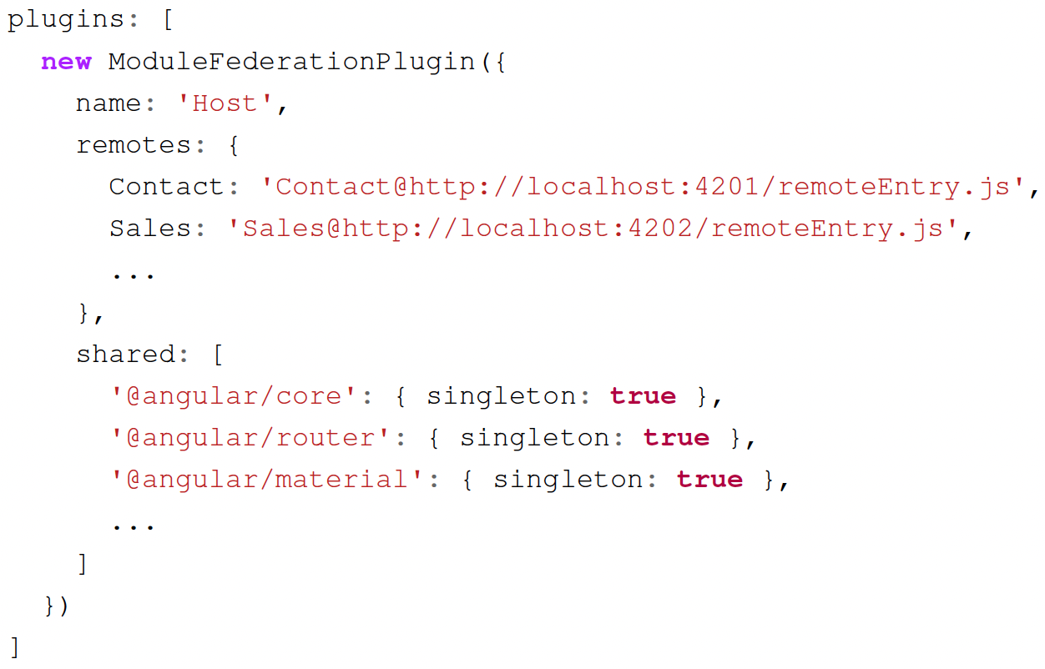
Configuring Module Federation (Host)
Notes:
The figure shows the configuration of the application-shell. The name of the application has to be defined. This is optional for application shells, as they are not shared, but it is best practice to also define a name for them.
The remotes-object specifies the modules that should be consumable by the application shell. It consists of an ID and an associated URL. The contact micro-frontend has the ID contact and the URL localhost:…

Slide 54
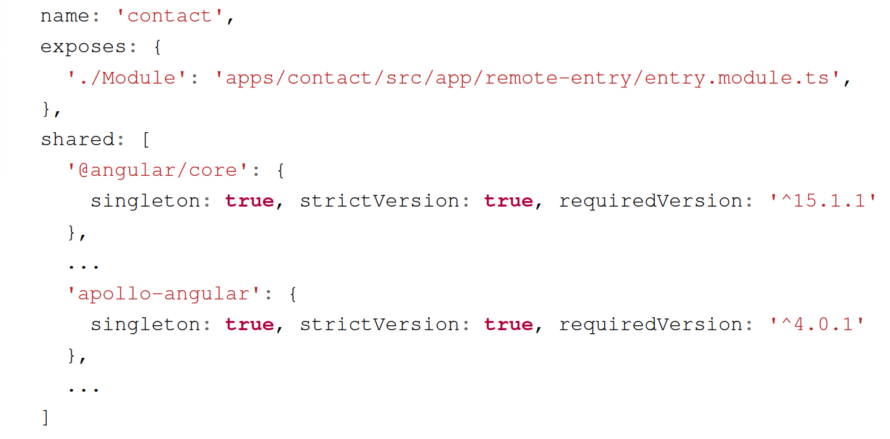
Configuring Module Federation (Remotes)
Notes:
This shows the Module Federation configuration of the contact micro-frontend. It stated before a name has to be given to the contact micro-frontend. The expose option can be used to define the functionality that should be consumable by other applications using Module Federation.
The shared section describes the libraries that should be shared through Module Federation. How the dependencies are shared can be configured in various ways. The dependencies that should be shared need to be explicitly stated. Singleton specifies that the library can be only loaded once. RequiredVersion can be used to define the required version of the dependency. StrictVersion can be used to specify that an exact version has to be used, otherwise an error is thrown.

Slide 55
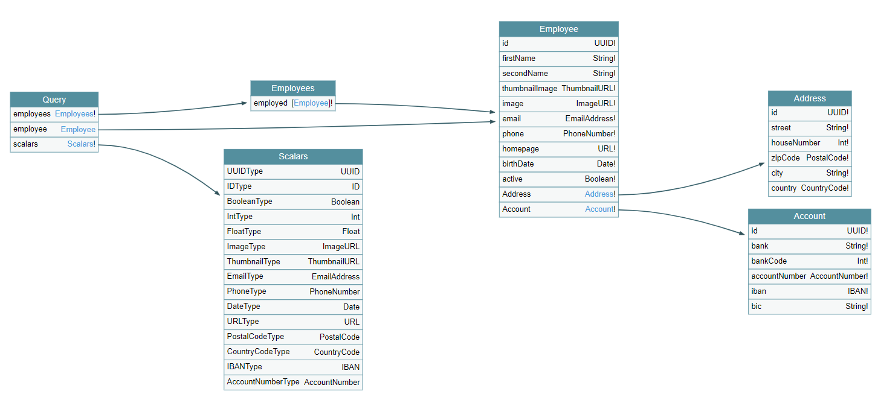
GraphQL Advantages
Reduces network traffic between the clients and the service they query.
The client specifies the fields to be fetched, which reduces the complexity on the backend.
GraphQL can query its own schema, which allows service discovery potential.
Notes:
GraphQL helps to reduce the network traffic between the clients and the service they query. Research indicates that the dynamic approach to fetching data can reduce the number of fields to be fetched and, therefore, the bytes sent back and forth to the server.
The specification of the fields to be fetched reduces the complexity on the backend. The backend service does not need to implement an endpoint for each client’s request. A GraphQL API is a single endpoint with multiple possible operations.
GraphQL can query its own schema, allowing service discovery potential. GraphQL allows tools like GraphQL Voyager to visualize the schema in UML like style. An example of such a schema is shown on the slide. REST does not provide such a functionality out of the box.

Slide 56
GraphQL Disadvantages
Consuming GraphQL APIs leads to higher complexity in comparison to REST.
Each field that should be queried needs to be explicitly specified.
GraphQL shifts the responsibility from the server to the client.
The structure of the query might mask the complexity of the query on the backend for the client.
Notes:
Consuming GraphQL APIs leads to higher complexity compared to consuming REST. Clients just need to fetch data from a single endpoint with a REST service. With GraphQL each field that should be included in the response must be specified. The introspection abilities of GraphQL allow consumers to understand better the query and data structure, which mitigates the disadvantages. GraphQL shifts responsibilities from the server to the client, with a gateway. API composition can transfer the responsibility from the server to the client.
Allowing the client to specify the structure of query might the potential complexity of the query not transparent to the client. The approach makes it possible that the client may specify a query which does not complete in a reasonable time or takes up a lot of resources.

Slide 57

Prototype’s architecture
Notes:
The first step was to implement a prototypical micro-frontend application to evaluate the hypothesis. The micro-frontends were integrated using a client-side integration with the help of Module Federation. Most of the implementation was written using Angular, while one widget was implemented in React to showcase the technology agnostic approach of the caching strategy. The application is divided into nine widgets that display only simple data and four complex SPAs. The four SPAs are Dashboard, Contact, Sales and User.
The figure on the slide shows a wireframe of the structure of the application. The icons in the square represent the JS Framework used. Each widget is a separate micro-frontend that exposes a module through Module Federation, which is consumed by the Dashboard micro-frontend.
Each micro-frontend is a complete application and deployed separately and is accessible by a separate URL. The application shell is the entry point for the client, and it consumes the Dashboard, Contact, Sales and User application. The main functionality of the application is encapsulated into modules. These modules can be easily accessed through module federation and used by the application shell. The standalone application consumes the modules in the exact same way.

Slide 58
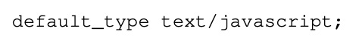
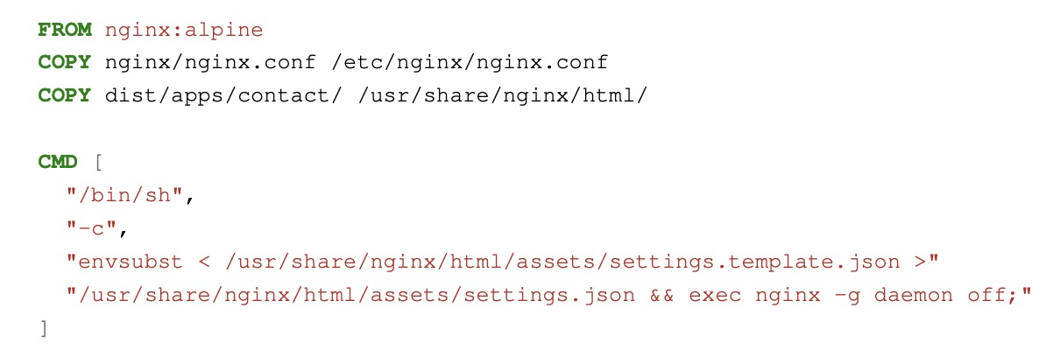
Deployment Problems
Nginx in docker containers are used to run the micro-frontends in production.
Nginx does not recognize the mime-type .mjs.
Set the default mime-type to
Notes:
Nginx web-server inside a docker-container are used to deliver the application files to the application. The dockerfile for the micro-frontends is shown on the figure. The application needs to be built before dockerizing the application.
Module federation applications by default export a remoteEntry.mjs, which can be consumed by the application shell. But Nginx does not know the mime-type for .mjs files. The mime type stands for Esmodules to enable compatibility with node.js. Therefore, it falls back to the default mime-type, which is text/plain. This does not execute the JavaScript inside the file.
To circumvent this problem, a custom nginx-config had to be created, which sets the default mime-type to text/javascript. This configuration does not break anything else, as modern framework like angular just work with js files.

Slide 59
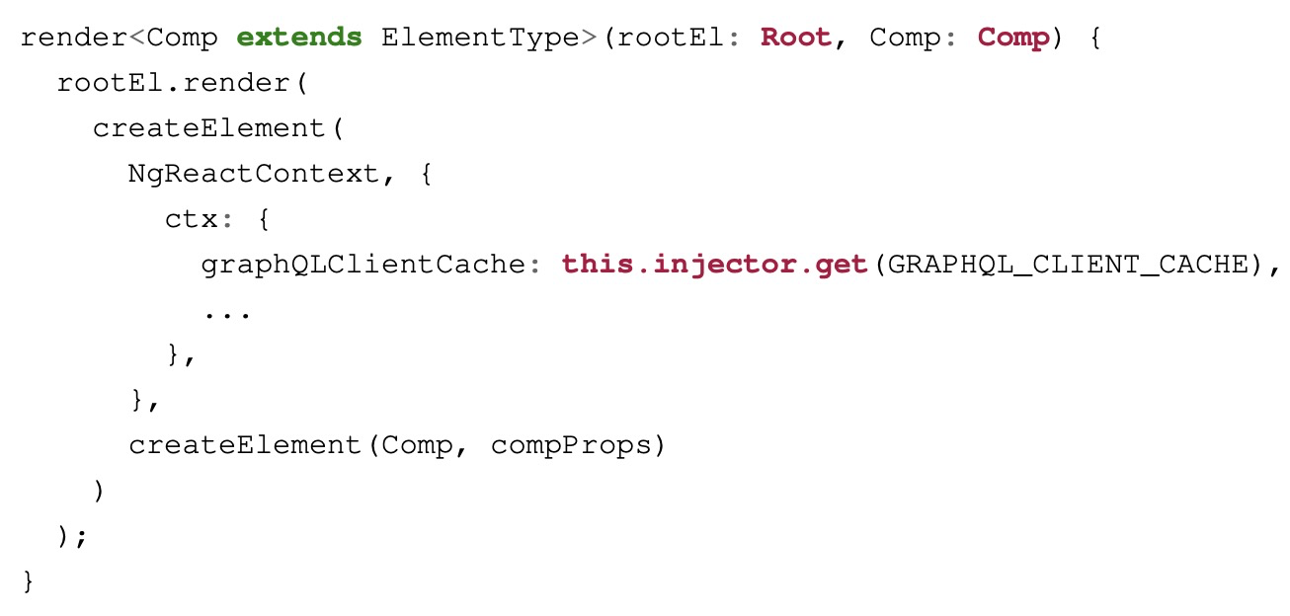
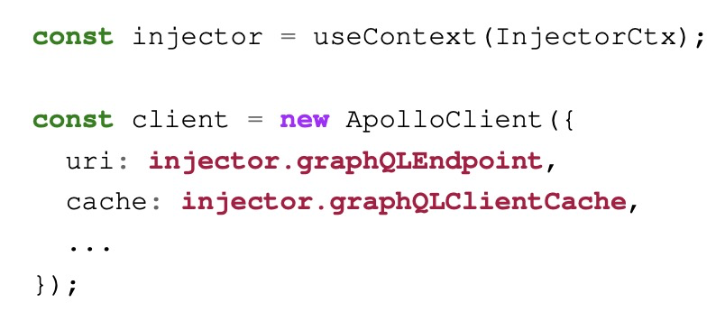
Integrate React
Notes:
One widget of the Dashboard was implemented using React. The integration of another framework was done to showcase, that the cache instance of Apollo Client can be shared across different technologies. The functionality of the React widget is exposed through Module Federation. React does not have the concept of modules as Angular, therefore the functionality is exposed as a component.
Rendering a React application inside an Angular application is not possible that easily. Therefore, I had to write an adapter in Angular that renders the React component. The adapter loads the remote bundle and renders it inside the View Container of the Angular component. The Angular adapter makes it also possible that the Angular routing points directly to the component.
Angular modules, which are consumed through Module Federation can access the dependencies from the dependencies from the application-shell. But React can’t access the dependencies through dependency injection. React does not offer a dependency injection system like Angular. React offers a system called context to enable such a functionality.
The React micro-frontend needs the cache instance from the application shell in order to hook into the shared caching layer. Therefore, the Angular adapter creates the React component inside a context, which has the necessary information.

Slide 60
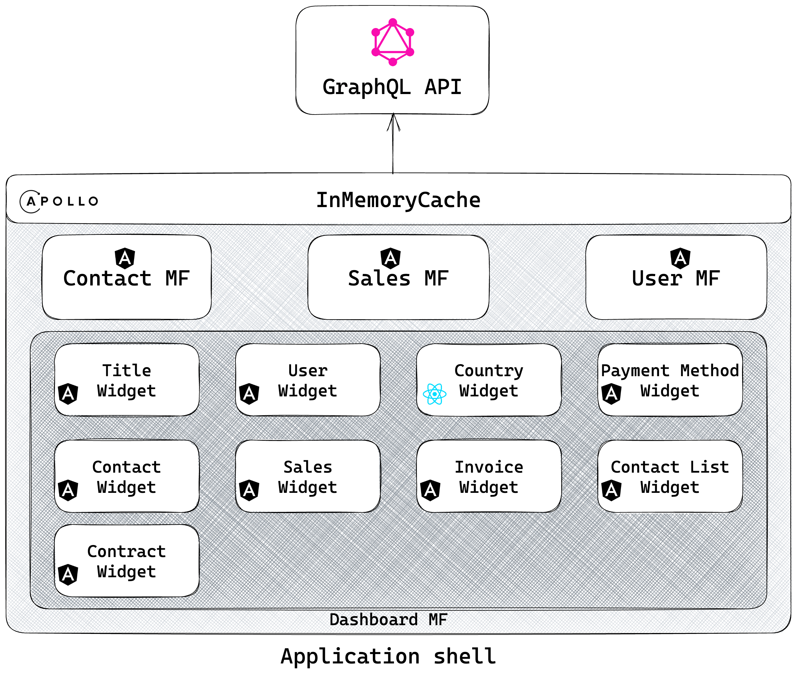

Backend-For-Frontend
Notes:
A single BFF pattern is used for all micro-frontends of the architecture. Apollo Server was used as the technology to implement the GraphQL API. Every micro-frontend uses the same instance of the GraphQL API, however in theory multiple GraphQL APIs would be used. Each micro-frontend is a standalone application; therefore it could communicate with multiple GraphQL APIs.
The BFF fetches the data from multiple microservice APIs and brings the results into the correct shape for the micro-frontends. While developing the prototype mocked datasets were used. Large numbers of data were generated for the API.

Slide 61
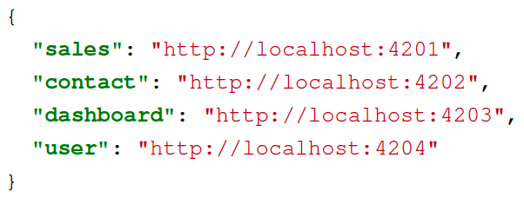
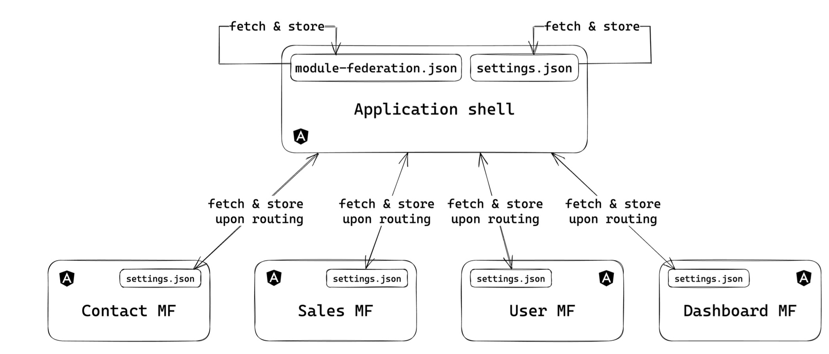
Application settings
Notes:
The prototype uses dynamic module federation. The locations of the micro-frontends is fetched from a JSON file, when the application shell is loaded. The problem with static Module Federation is that the URL of the micro-frontend must be known at build time. However, this is quite cumbersome, as the URL might be deployed to multiple stages and rebuilding the application a few time is unecessary. The application makes a GET request to fetch the module-federation.json file. The configuration of the micro-frontends is a simple mapping between the application name and the remote location. The configuration file can be configured for every environment.
The configuration of the micro-frontends is also fetched dynamically from the assets of the application. The settings are stored inside a service to be easier retrieved later. Angular provides a handy mechanism to execute logic at the startup. The APP_INITIALIZER token enables the execution of asynchronous code at application startup. Multiple functions can be registered that are executed in the order, they were registered. If one function fails, the application does not load.
The figure shows the process, of fetching and storing the settings. Each application stores its settings with a unique identifier that is the name of the application.

Slide 62
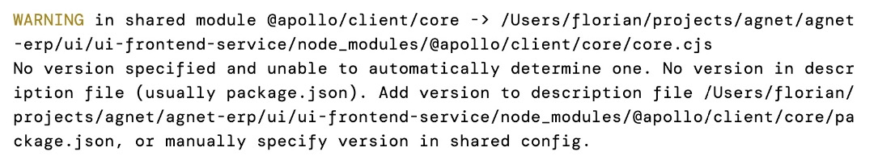
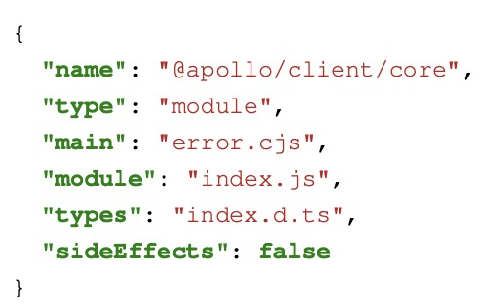

Share secondary entry points
@Apollo/Client has secondary and tertiary entrypoints, which causes troubles with Module Federation.
Notes:
All dependencies of the prototype are shared through Module Federation. The options are singleton, strictVersion and requiredVersion. The versions of the packages are automatically determined from the package.json. Some dependencies have troubles, when having these settings.
The dependency @apollo/client has troubles with this approach, because it has secondary and tertiary entry points. The warning message is printed by Webpack, if the following dependencies are going to be shared: @apollo/client/core, @apollo/client/link/batch and @apollo/client/link/error.
The problems are the secondary entrypoints, which are like npm-packages in npm-packages. The content of the package.json of @apollo/client/core is shown on the slide. The package.json has no version-field and Webpack tries to resolve the version of the secondary entrypoints to be able to share it. This does not lead to an error in production, but the dependency is included in every micro-frontend bundle.
The solution to this problem is to specify the version for all dependencies that start with @apollo/client.

Slide 63

Communication layer
Notes:
Two micro-frontends should not communicate directly with each other, as it creates tight coupling. And it hinders parallel development. It is better to communicate indirectly. The micro-frontends can communicate indirectly by publishing an event to an event-bus, where another micro-frontend listens, or they communicate with the help of the application shell. The pattern is known as publish/subscribe mechanism. The application shell can also orchestrate the communication, where one micro-frontend emits an event, that the other micro-frontends listen to. The micro-frontends should not have implementation information about the other micro-frontends.
Angular offers dependency injection for implementing communication between micro-frontends. The application shell can provide services that the micro-frontend can inject. The standalone application that also provide the service, therefore the implementation is exchangeable.
I have created an injection token, that specifies whether the application runs in standalone mode or is embedded into the application shell. Additional logic is executed, if the micro-frontend is executed in standalone mode. One requirement of the application is that the micro-frontends should be able to integrate their layout into the application shell. The figure on the slide shows how this should look like. A layout service was created that register a second navigation row, for the contact navigation. The first row contains the navigation of the application shell, which links to the different micro-frontends.
The left side of the slide shows the standalone contact application, whereas the right side shows the application shell with the application shell opened.

Slide 64

Shared caching layer
Notes:
Each micro-frontend should have a separate instance of the Apollo Client, but a single instance of the in-memory cache. Therefore, each application can provide its own configuration, but the same cache instance is used. The application provides the cache instance and the micro-frontends inject it. The cache stores the results of GraphQL queries. The caching strategy reduces the number of requests to the server.
The concept behind the shared caching layer is to instantiate the cache instance inside the application shell and provide it to the micro-frontends. The injection token can be used to create the instance of the cache and inject it into the application.

Slide 65


GraphQL Client creation
Notes:
The prototype provides abstractions to create the necessary configuration for the Apollo Client more easily.
I have created an abstraction for the GraphQL Client creation. The module GraphQLClientOptionsModule hides the complexity of creating and providing an Apollo Client instance. The module should be used in every micro-frontend that needs GraphQL capabilities. If the micro-frontend is, then integrated into the application shell it has its own Apollo Client. This helps independent development, because each team can configure their Apollo Client to their liking. The application shell might have different settings for the Apollo Client, which might introduce troubles in the contact micro-frontend. The module tries to inject the GRAPHQL_CLIENT_CACHE injection token and use it for the creation of the Apollo Client. If the token can’t be injected, a new instance is created. The process can be further configured, if the GRAPHQL_CLIENT_OPTIONS_CONFIG injection token is used.
Explain the options of the config.

Slide 66

First user journey

Slide 67

Second user journey

Slide 68

Example User reduction

Slide 69

Example Contract reduction

Slide 70

First User journey: first- and second-approach

Slide 71

First User journey: first- and third-approach

Slide 72

First User journey: second- and third-approach

Slide 73

Second User journey: first- and second-approach

Slide 74

Second User journey: first- and third-approach

Slide 75

Second User journey: second- and third-approach

